Slide 1
Kinnerley Parish Council Flood Protection Working Group 11 February 2021 (updated to 11/5/21)
Severn / Vyrnwy Confluence and flooding

Slide 2
Impetus for starting up KPC FPWG was news of the plans for a dam north of Shrewsbury
Try to keep everyone in the loop, not just KPC
A whistle-stop run through of flooding issues
Some have lived with flooding here for 80+ years, some are new to it
Thanks to everyone who has helped with photos and sources
Shoot me if you disagree

Slide 3
The Catchment Area
Morda
Perry
Tanat
Tern
Vyrnwy
Cain
Vyrnwy
Twrch
Vyrnwy
Severn
Severn
Banwy
Rea
Cound
Rhiw
Camlad
Carno
Trannon
Mule
Clywedog
Severn
Severn
Dulas
Showing monitoring stations

Slide 4
But it’s not the areas, it’s the rainfall that matters

Slide 5
Rainfall - averages
Vyrnwy gauge
Dolydd gauge
2,000mm per year = 5.5mm per day
It’s not the averages that cause floods
What has changed as a result of Climate Change? An average rise of up to 1m in levels is again not what matters
EA say the river system is now responding differently and the modelling can’t rely on history
Severn Uplands Local Environment Agency Plan Dec 1998 Map 15 p 121

Slide 6
Flooding
2020 and 2021

Slide 7
Rainfall - Vyrnwy rainfall gauge https://rivers-and-seas.naturalresources.wales/Station/1148?
These charts show the rainfall amounts during the 2020 and 2021 named storms
The Vyrnwy rain gauge recorded 515mm of rainfall making it the wettest February there since records began in 1908
Ciara, 9/2/20, 65.4mm
Dennis, 15-16/2/20, 81.2mm
Heavy rain, 21-24/2/20, 131.6mm
Jorge, 28-29/2/20, 62.8mm
Christoph, 19-20/1/21, 98mm

Slide 8
Rainfall - Dolydd rainfall gauge https://rivers-and-seas.naturalresources.wales/Station/1139?
These charts show the rainfall amounts during the 2020 and 2021 named storms
Ciara’s rainfall was most intense over North Wales; Dennis’s was worse in South Wales
Ciara, 9/2/20, 63.4mm
Dennis, 15-16/2/20, 84mm
Heavy rain, 21-24/2/20, 131mm
Jorge, 28-29/2/20, 81.8mm
Christoph, 19-20/1/21, 136.6mm

Slide 9
The 2020 floods at the confluence - inquest (8 December 2020 report to Communities Overview Committee)
Flood on flood on flood on flood
1. Storm Ciara 2. Storm Dennis 3. Heavy rain 4. Storm Jorge
8 – 9 Feb 20 15 – 17 Feb 20 21 – 24 Feb 20 28 Feb – 1 Mar 20

Slide 10
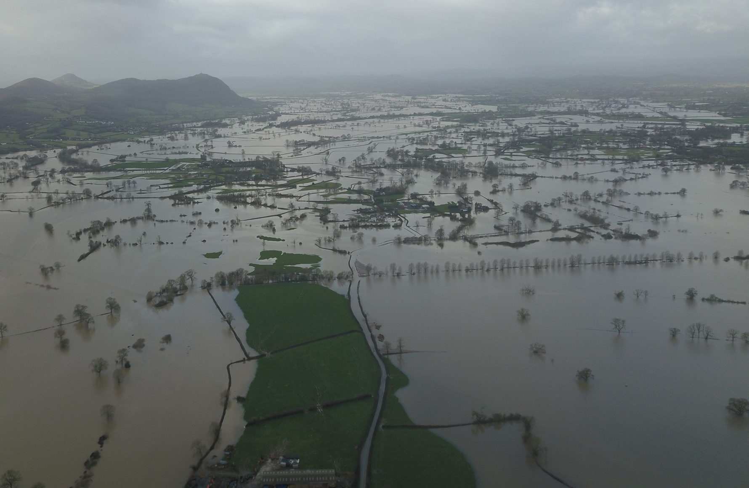
Aerial photograph of February 2020 flooding, taken over the Royal Hill

Slide 11
Pentre

Slide 12
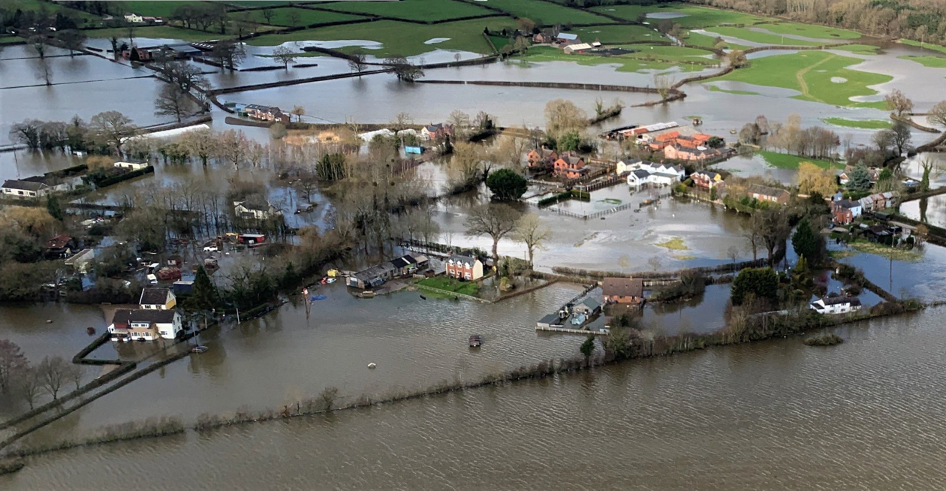
Pentre 26 February 2020

Slide 13
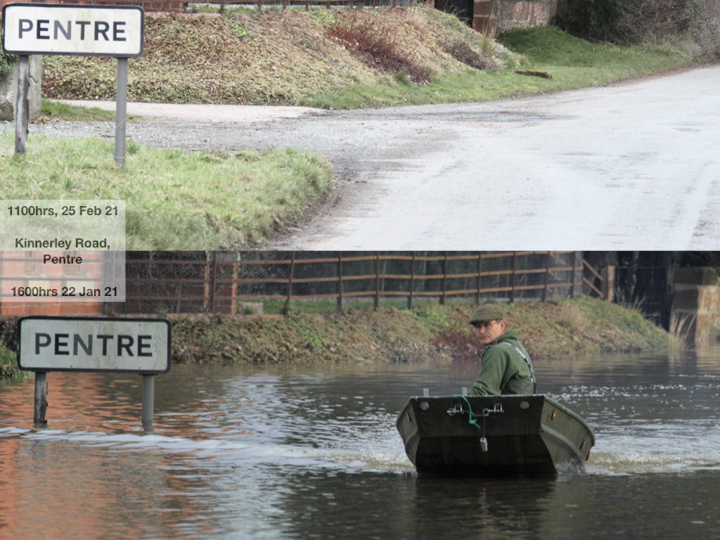

Slide 14
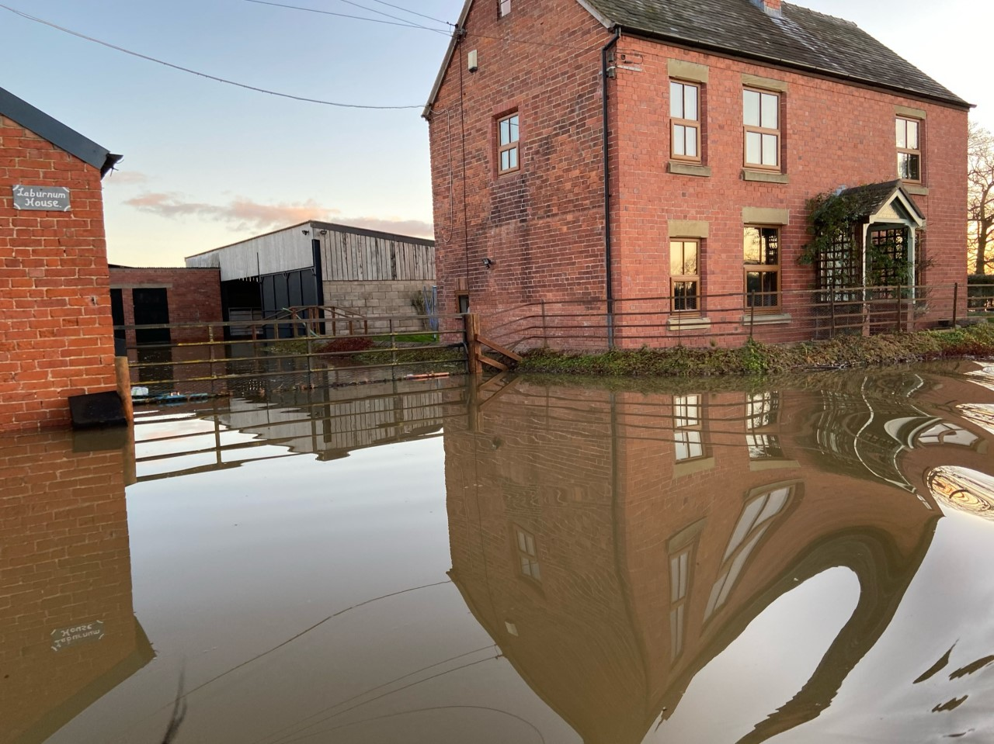
Pentre

Slide 15
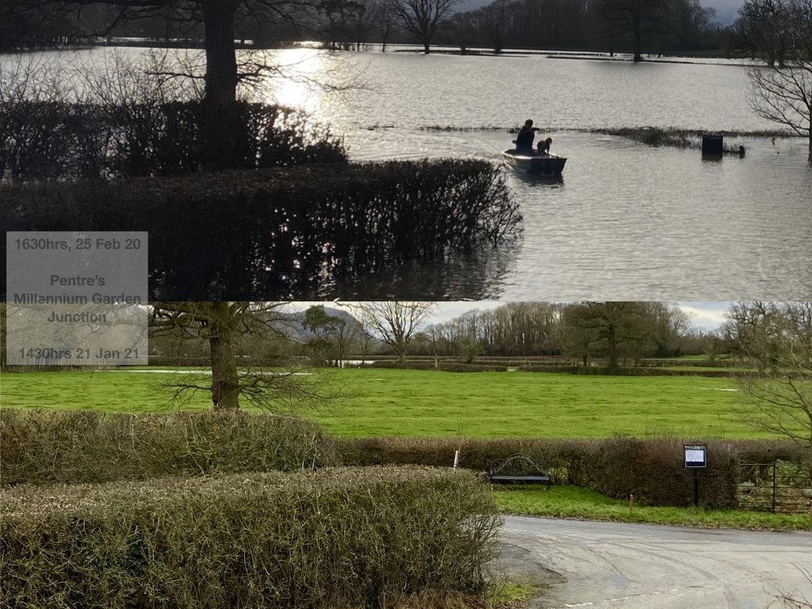
At the peak of the Feb 2020 floods
The Jan 2021 flood approaching
Pentre

Slide 16
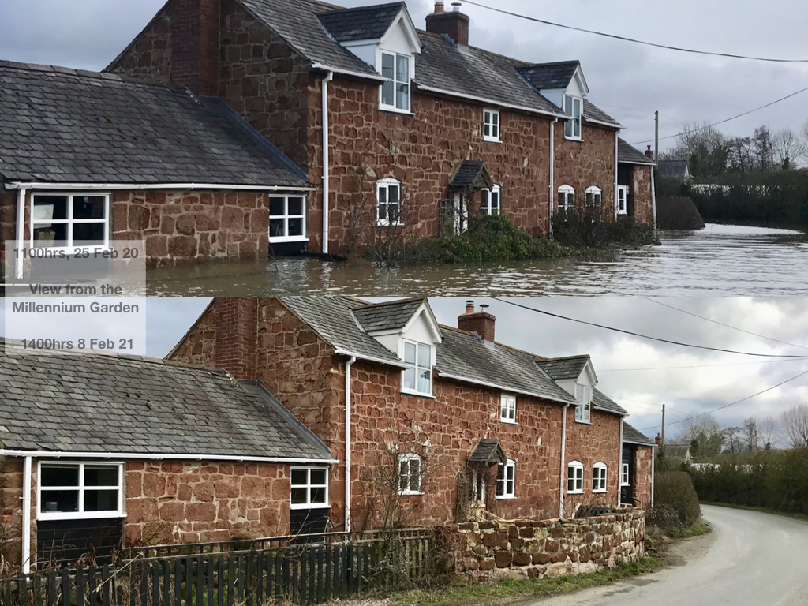
Pentre

Slide 17
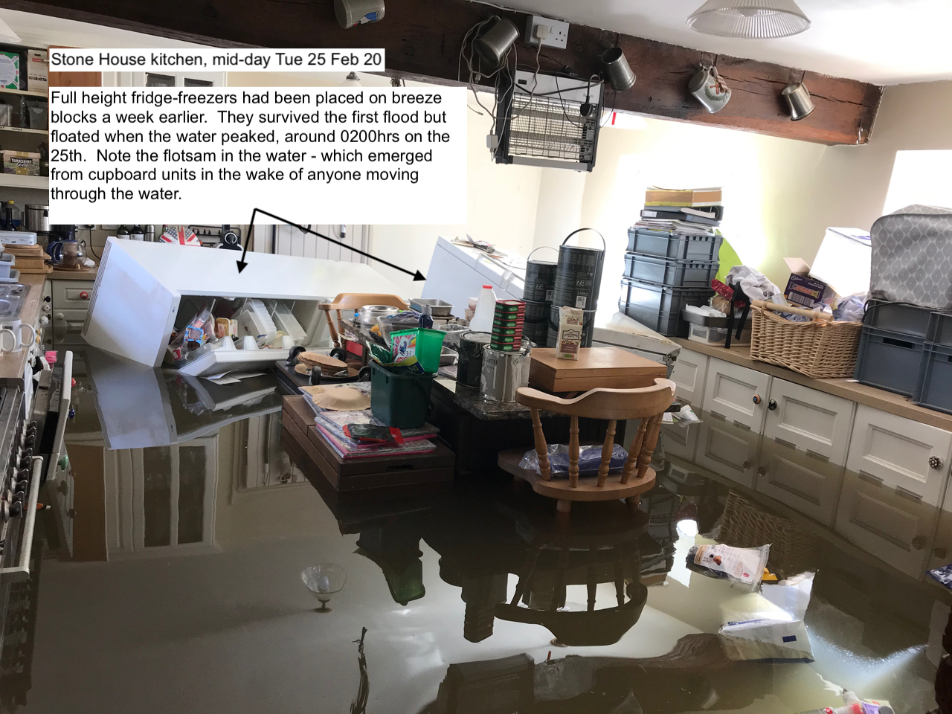
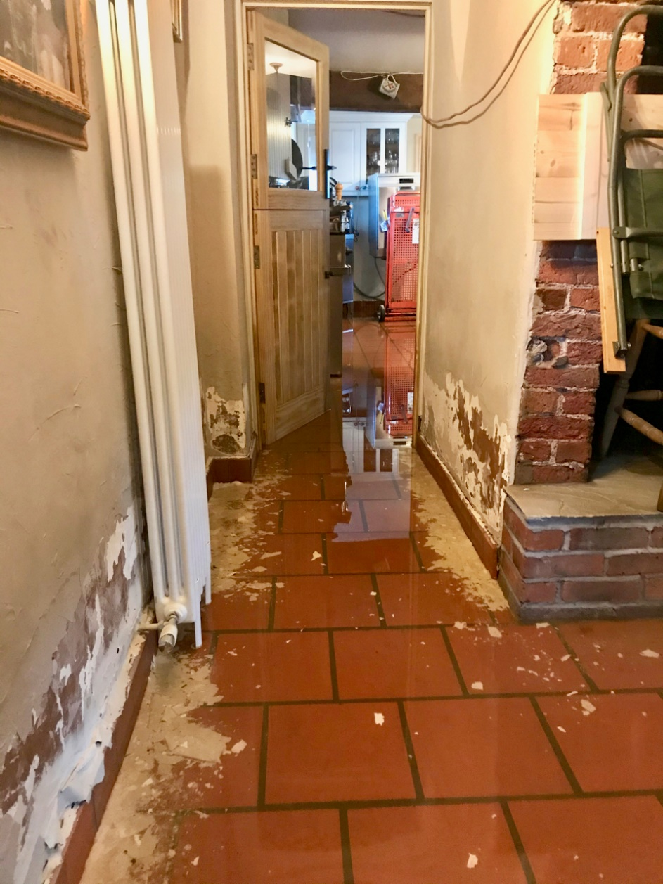
Damage revealed as the waters ebb, 22 Jan 21

Slide 18
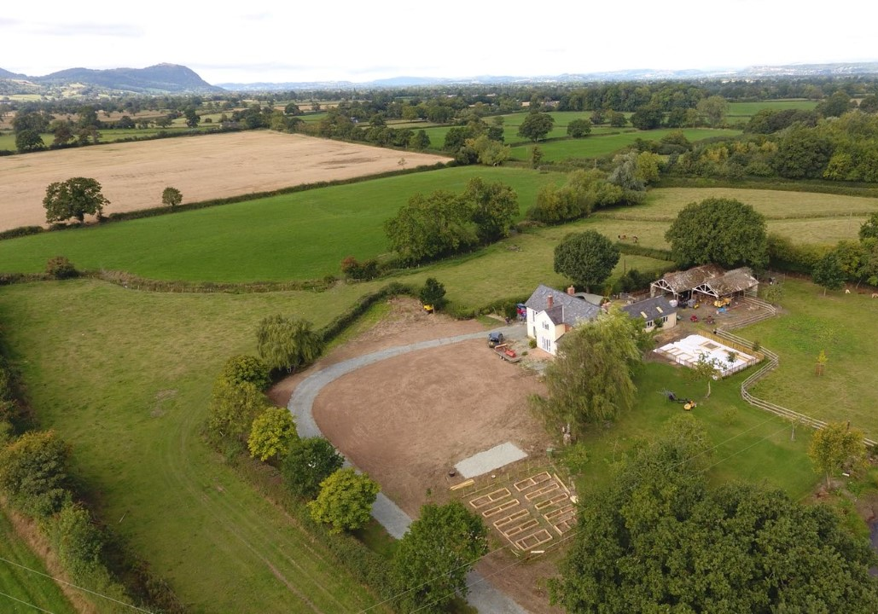
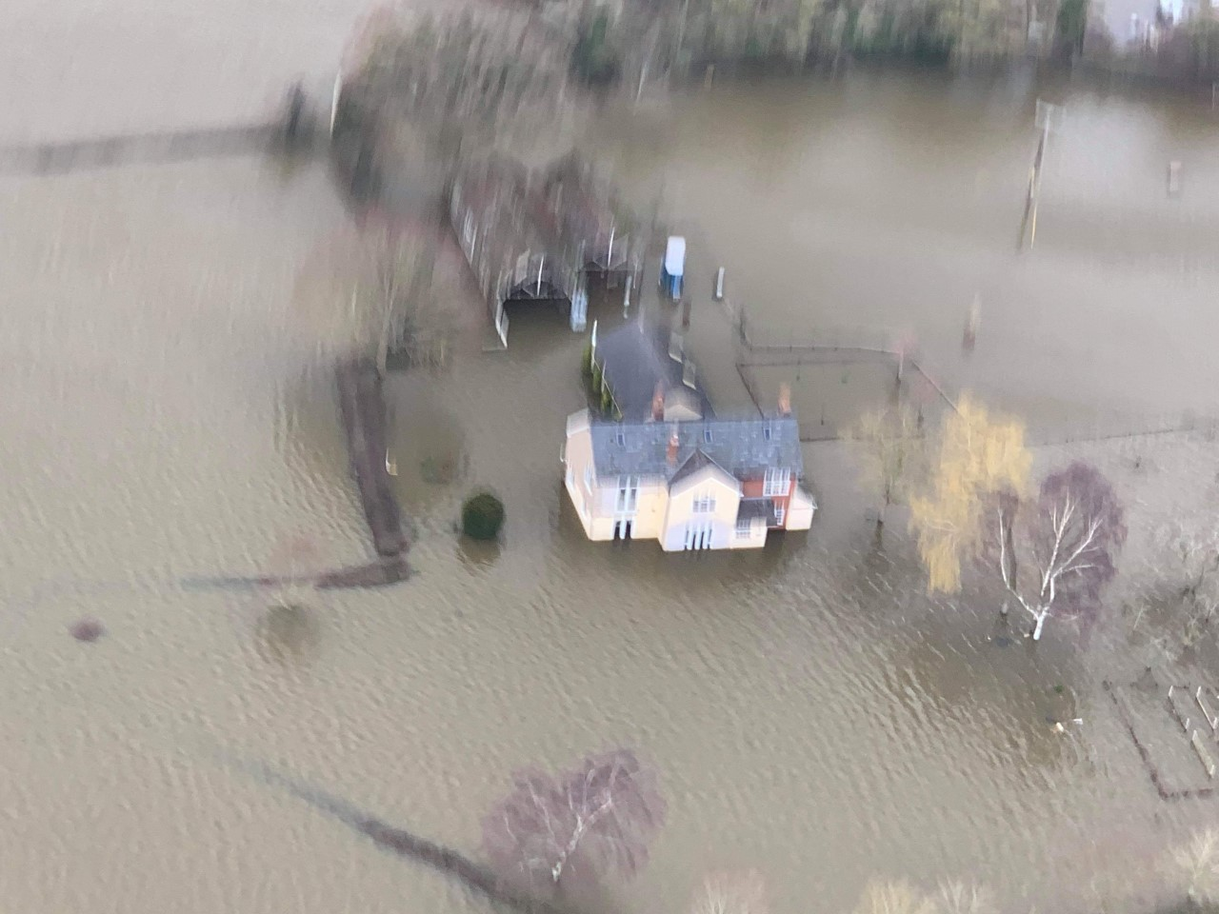
Pentre

Slide 19
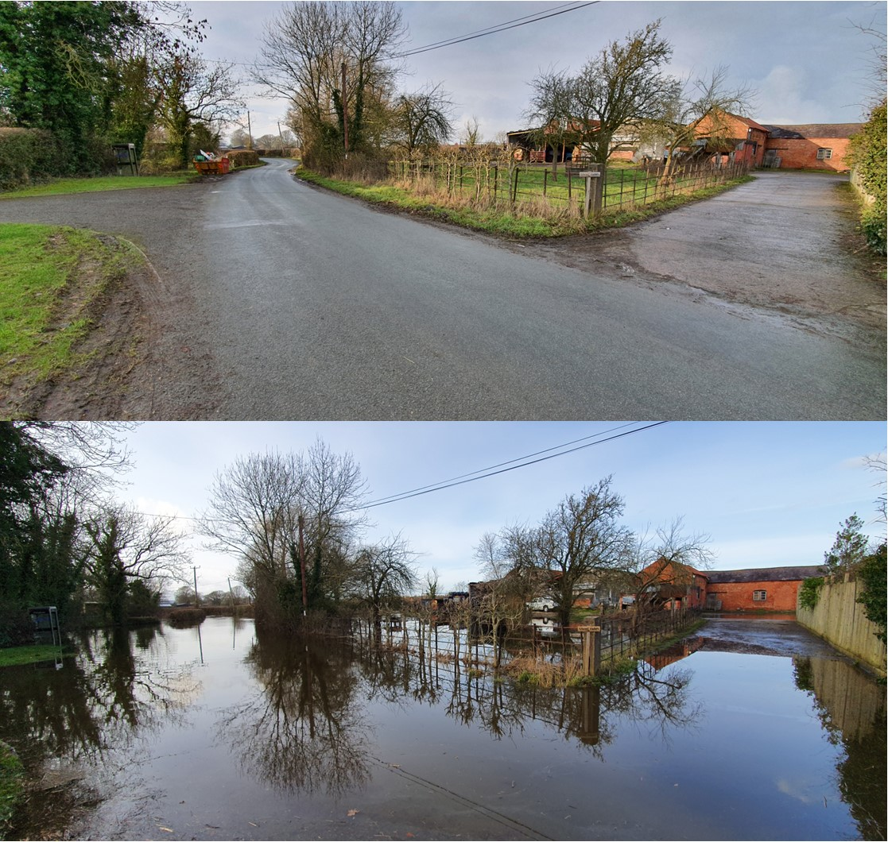
Grove Farm, Pentre

Slide 20
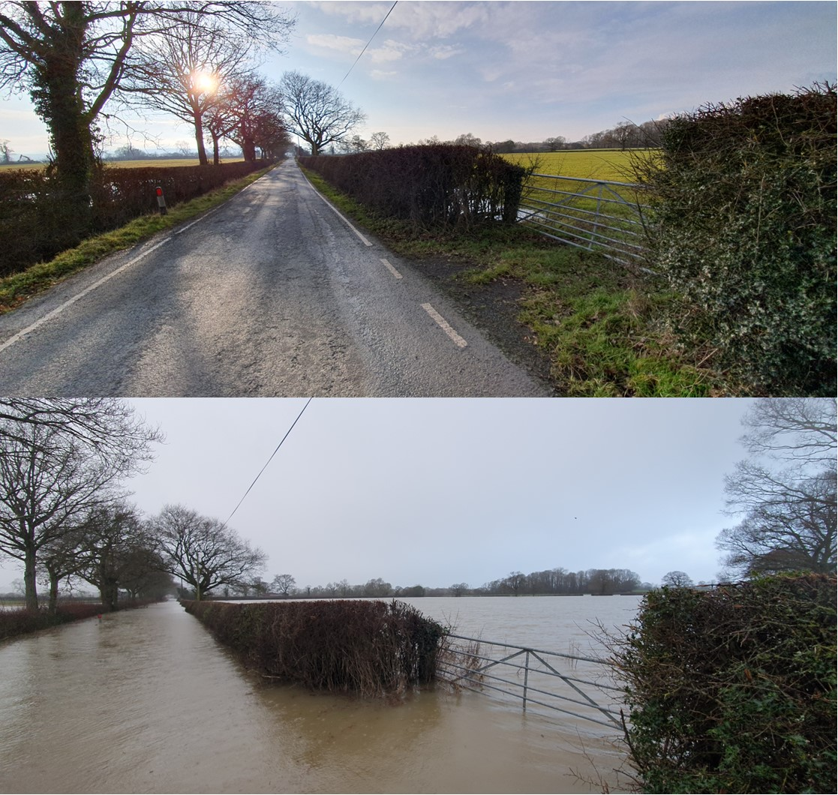
Pentre Common

Slide 21
Pentre Argae

Slide 22
Edgerley and
Farm Hall, Kinnerley

Slide 23
Lane by Duglands, Edgerley

Slide 24
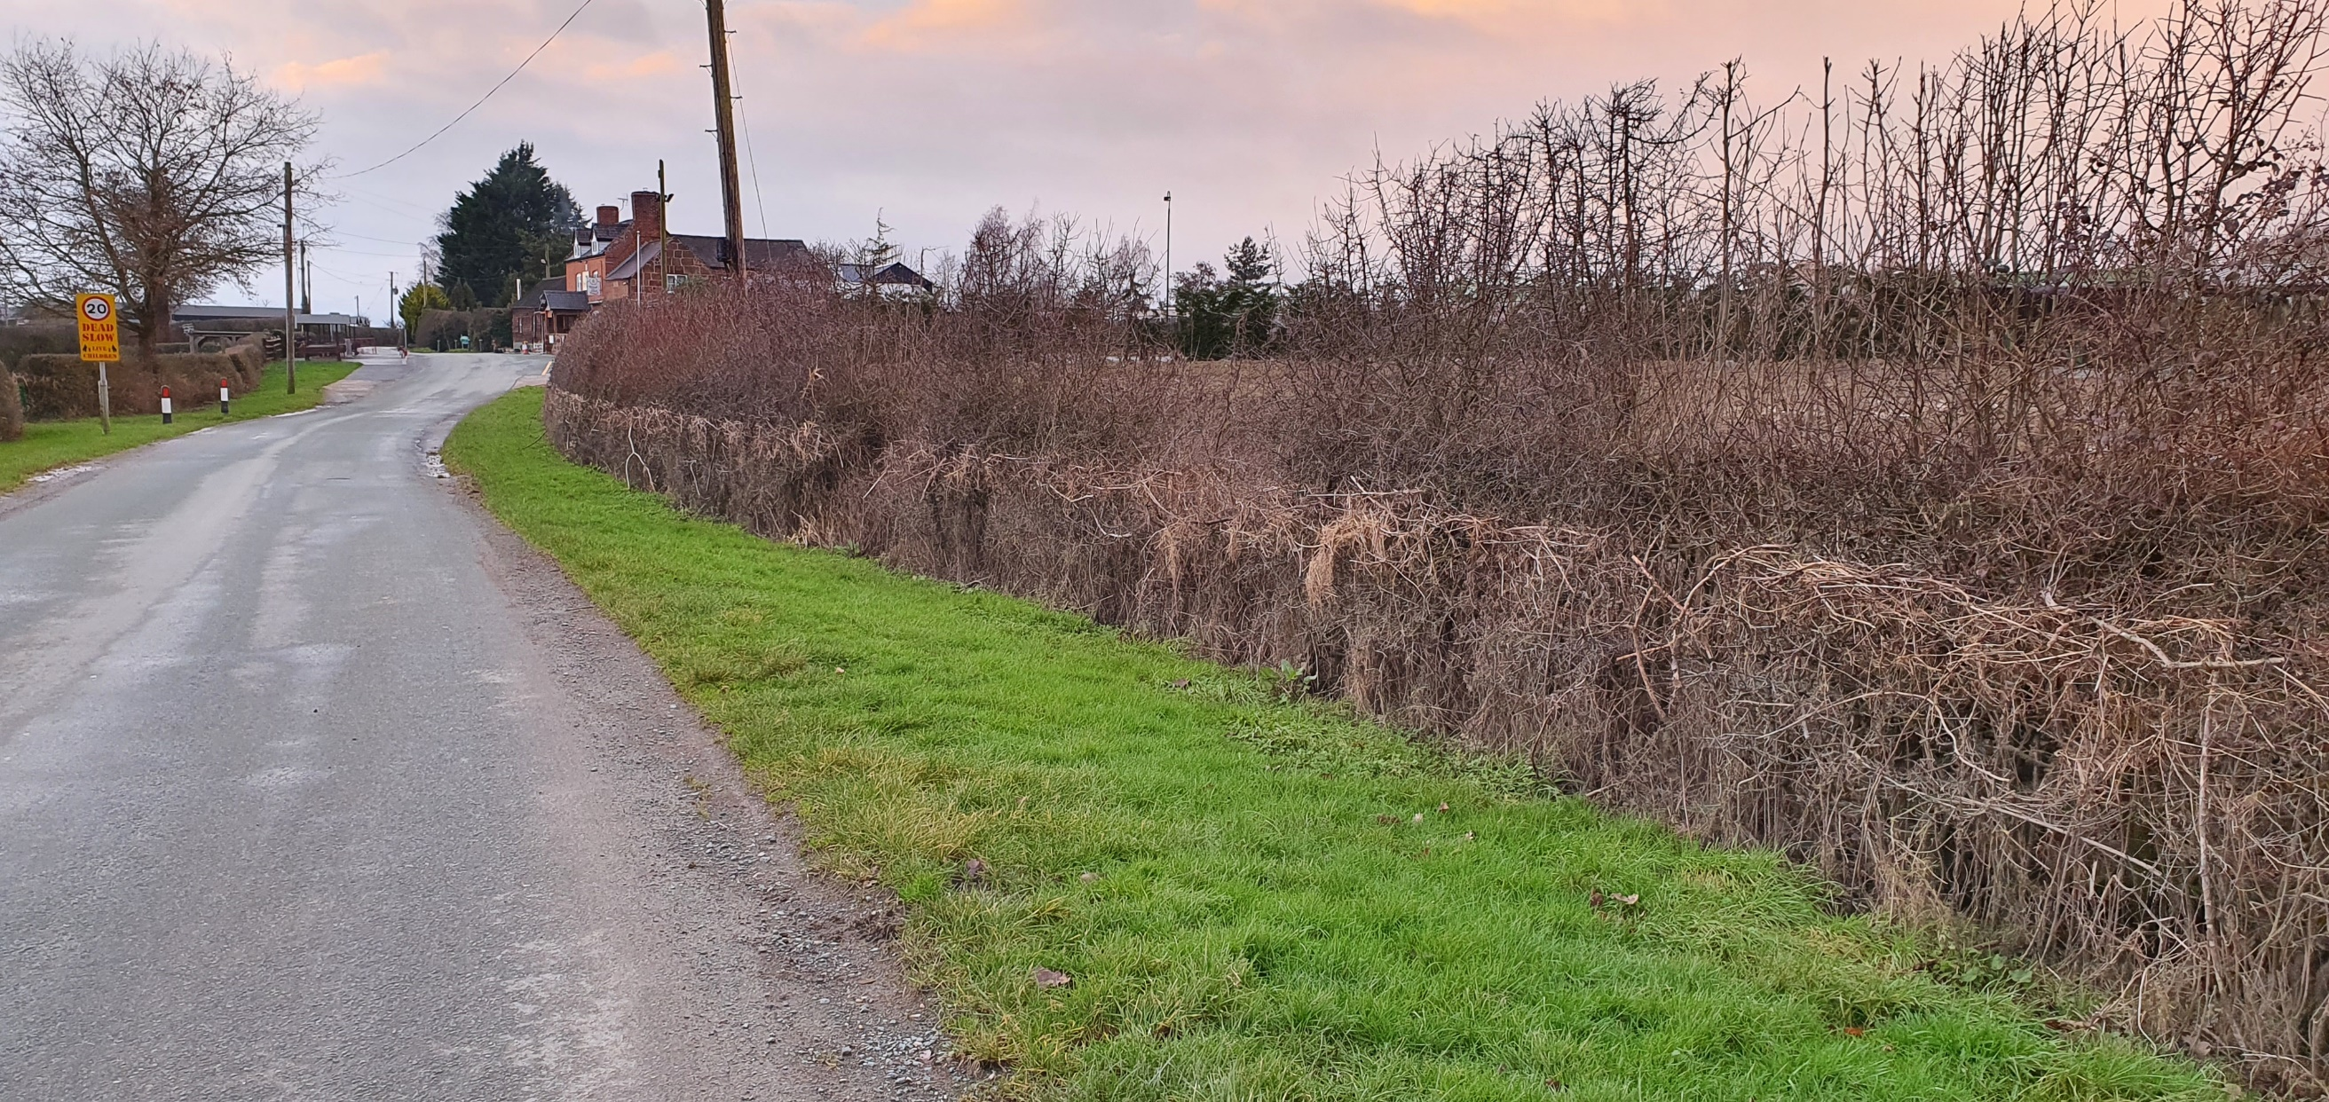
Royal Hill

Slide 25
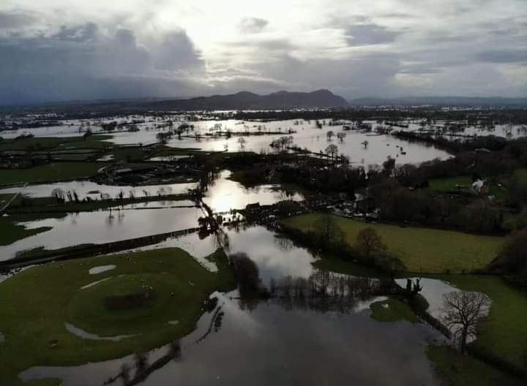
Farm Hall, Kinnerley

Slide 26
Farm Hall, Kinnerley

Slide 27
Farm Hall, Kinnerley

Slide 28
Melverley

Slide 29
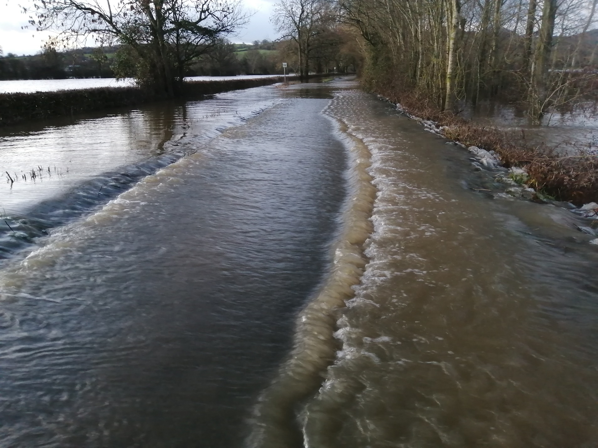
Road to Melverley bridge, flooding

Slide 30
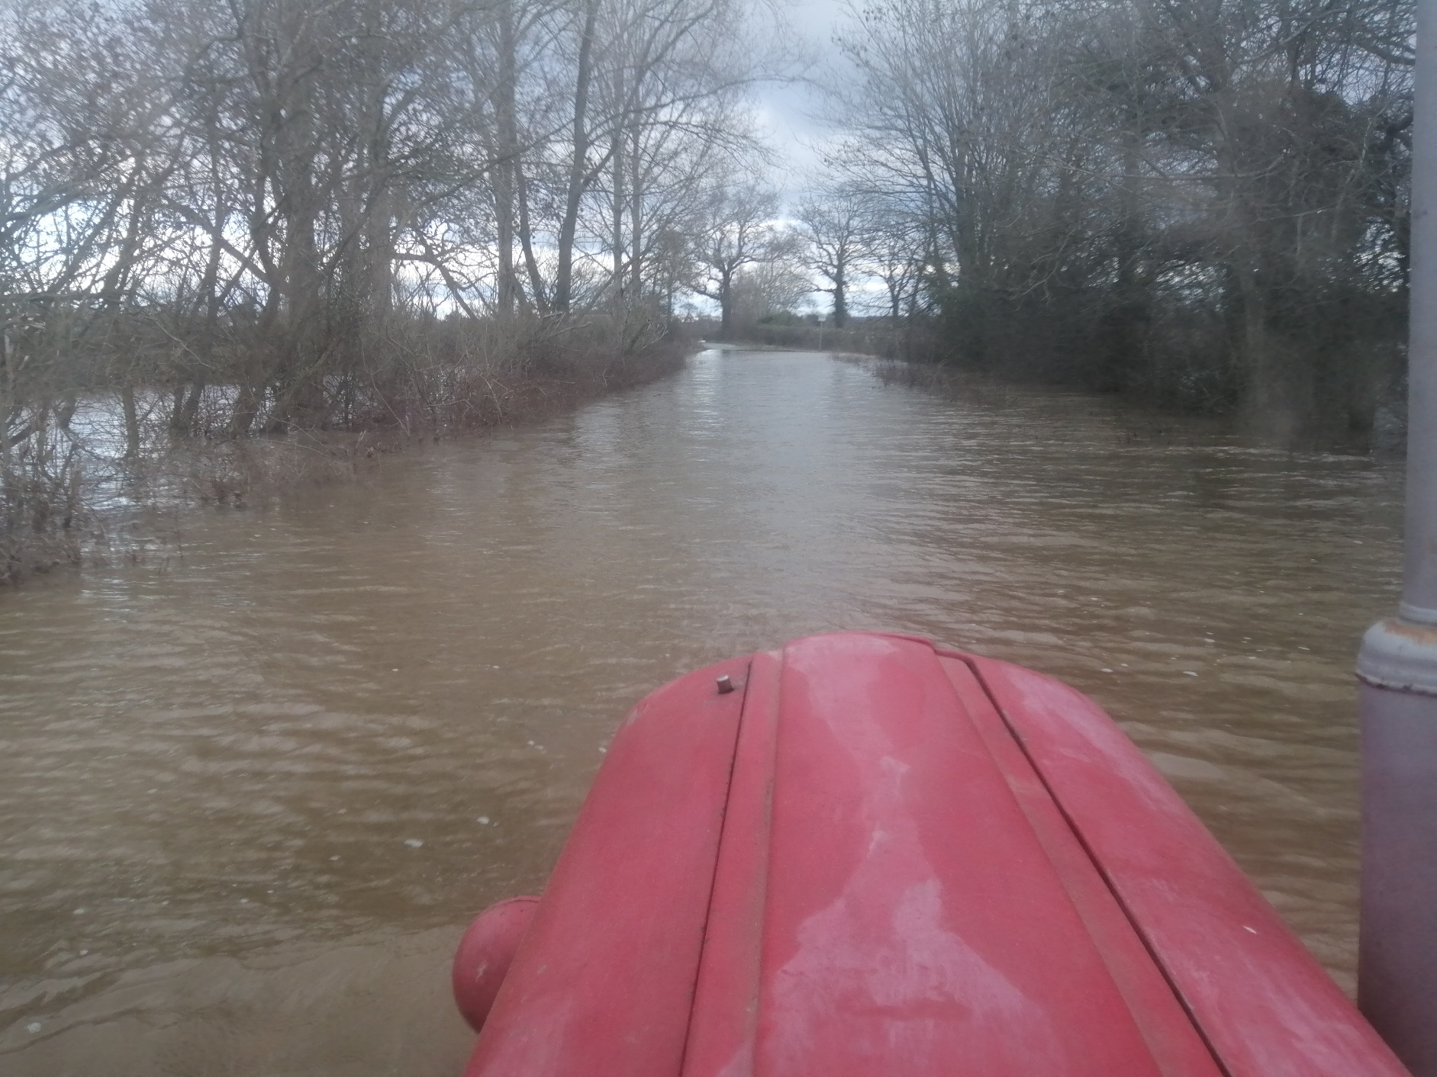
Road to Melverley bridge, flooded (access by tractor or boat only)

Slide 31
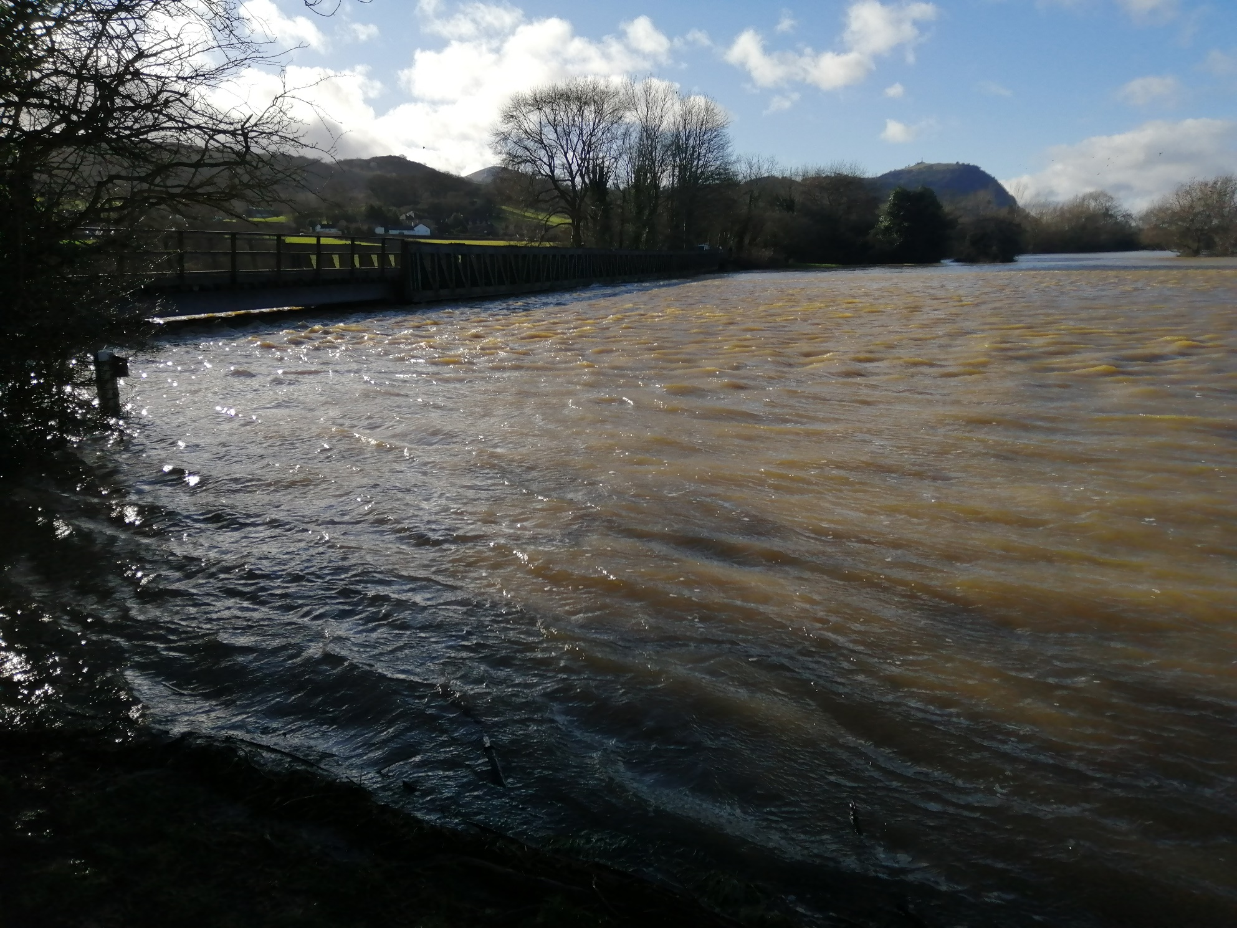
Melverley road bridge from upriver

Slide 32
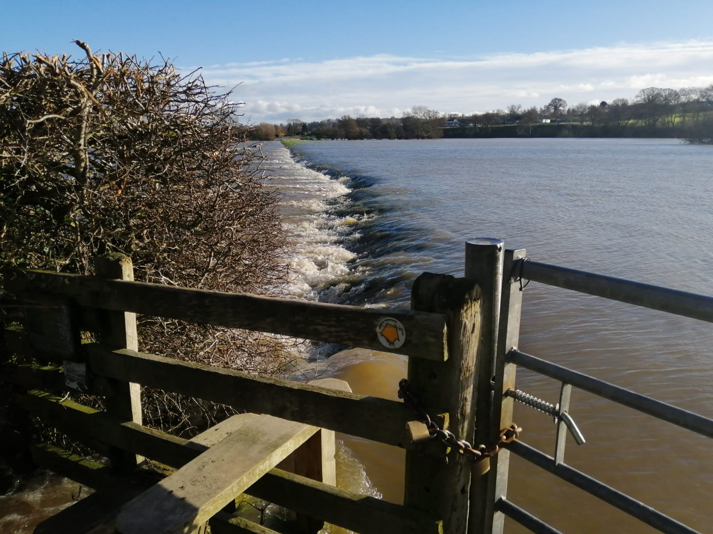
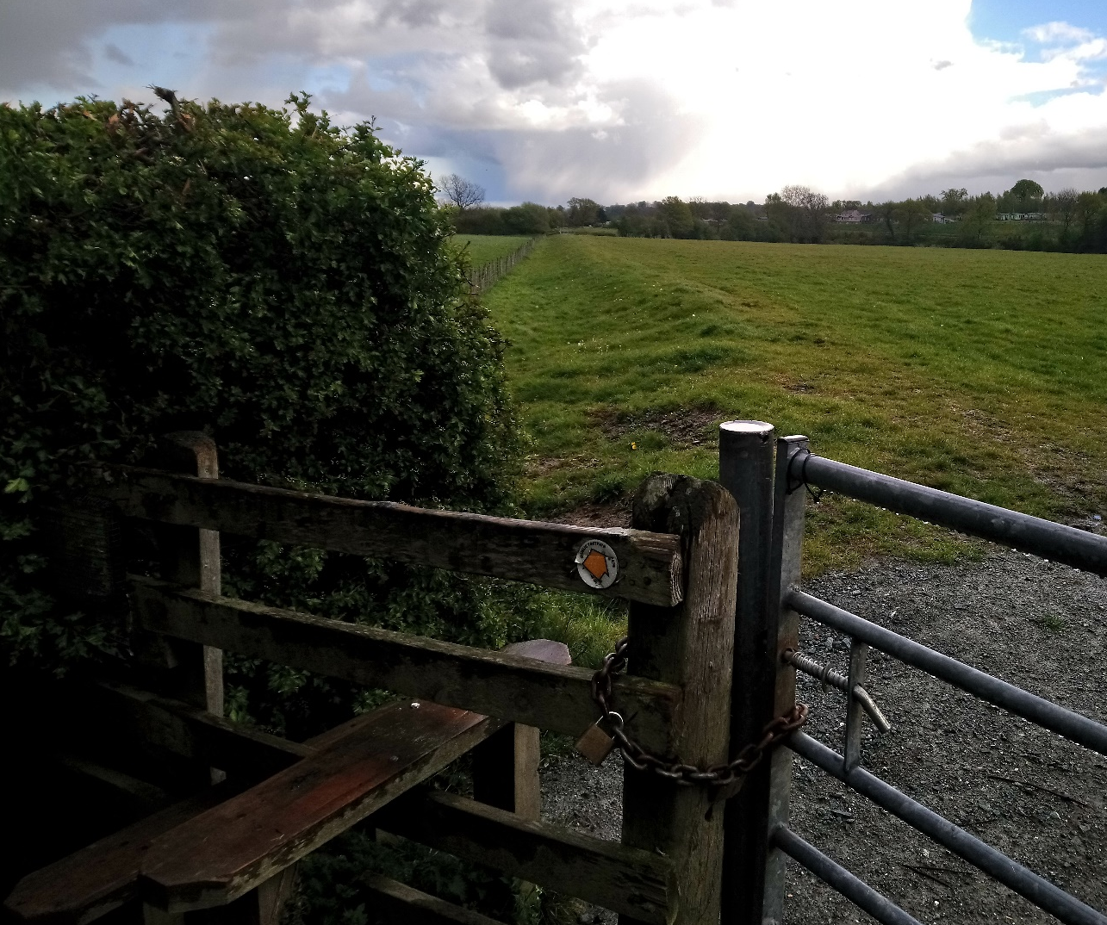
At Melverley bridge, looking downriver: argaes overtopped for 2 miles to Weirbrook outfall, Cae Howell

Slide 33
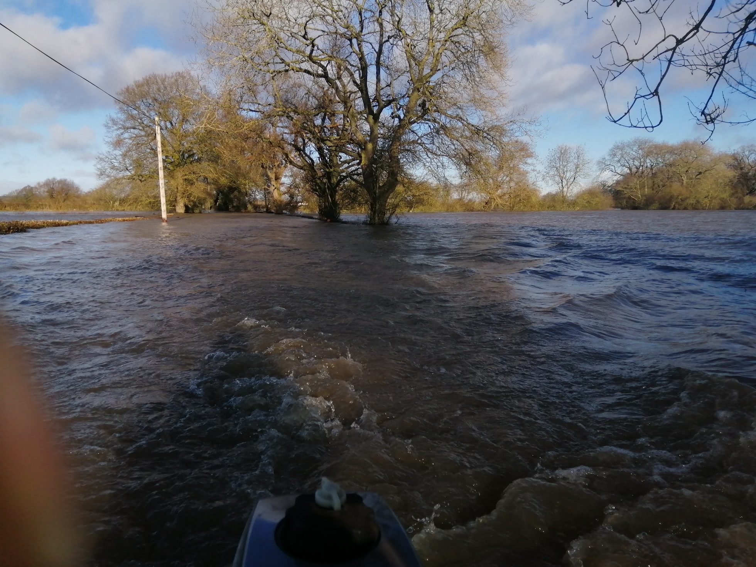
The Clewy (Rectory Corner towards Village Hall) by boat: the hedges were out of sight

Slide 34
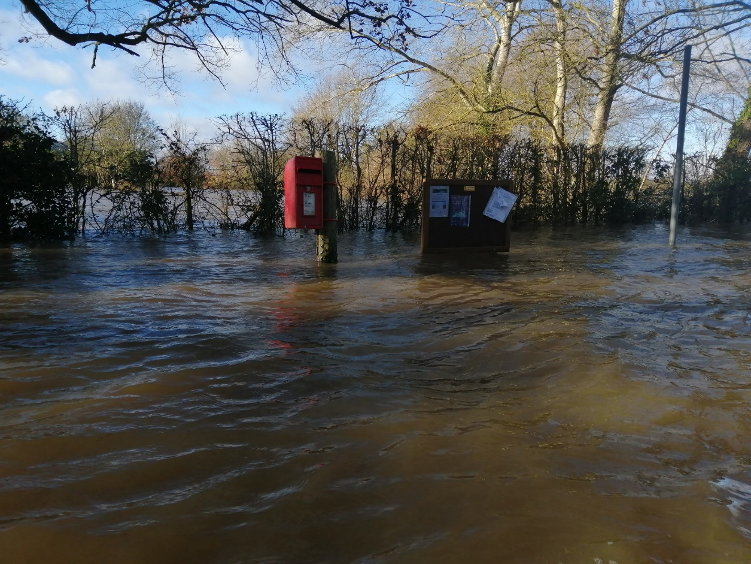
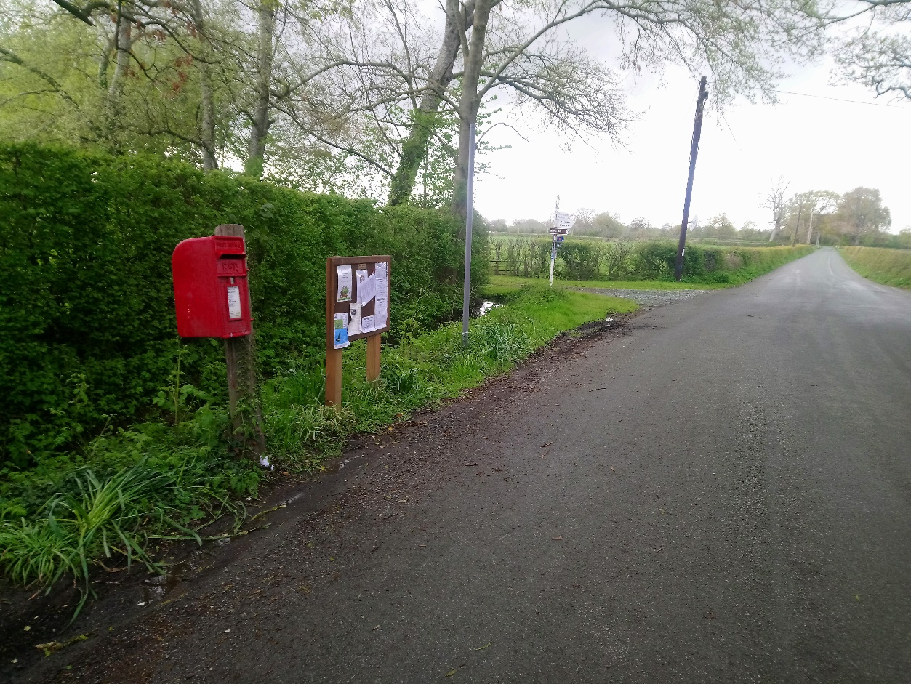
Melverley post box

Slide 35
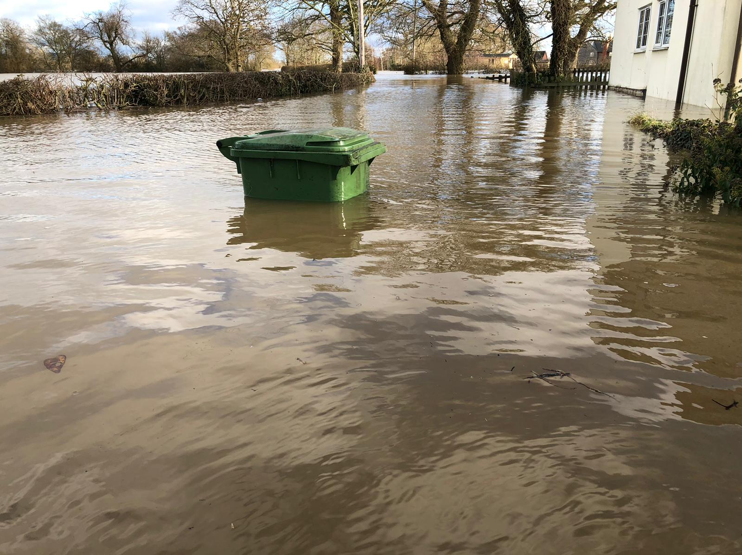
Chapel Lane

Slide 36
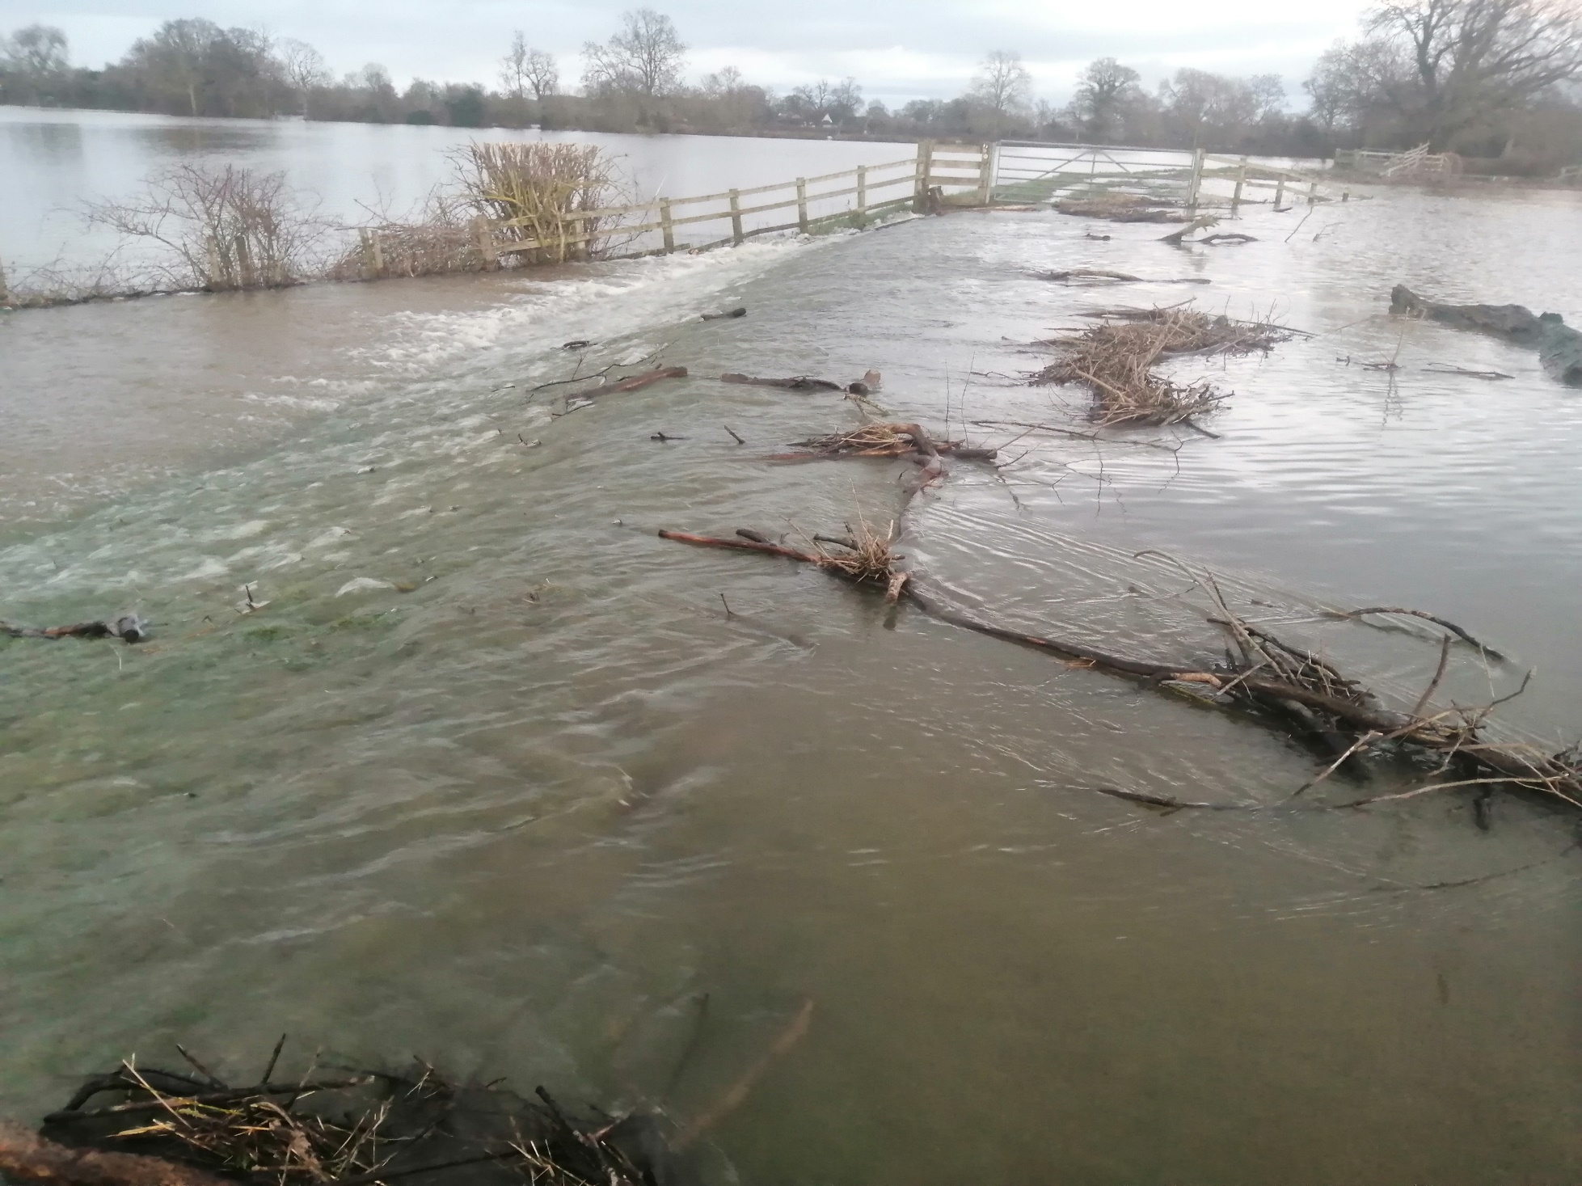
Overtopping argae at The Shores, Crow’s Nest

Slide 37
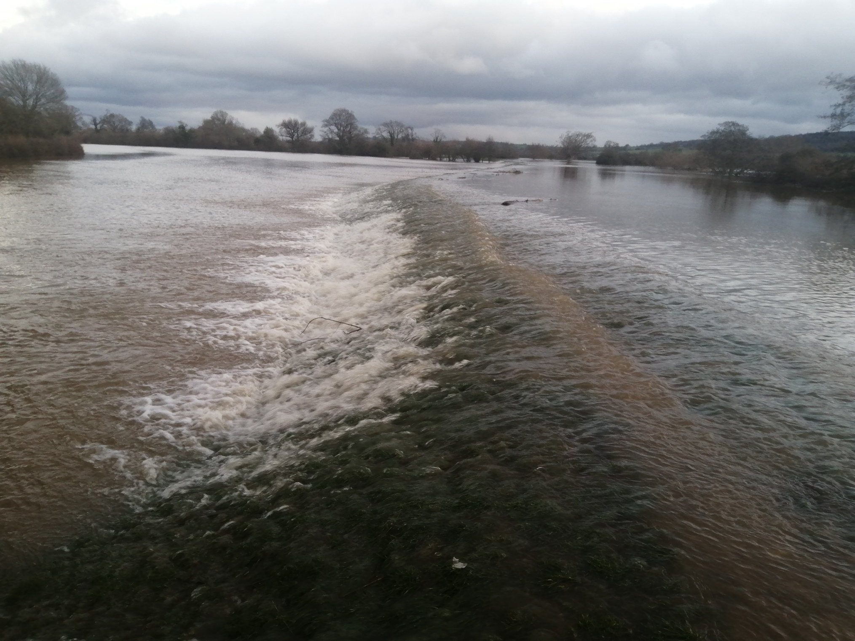
Overtopping argae downriver from The Hendre

Slide 38
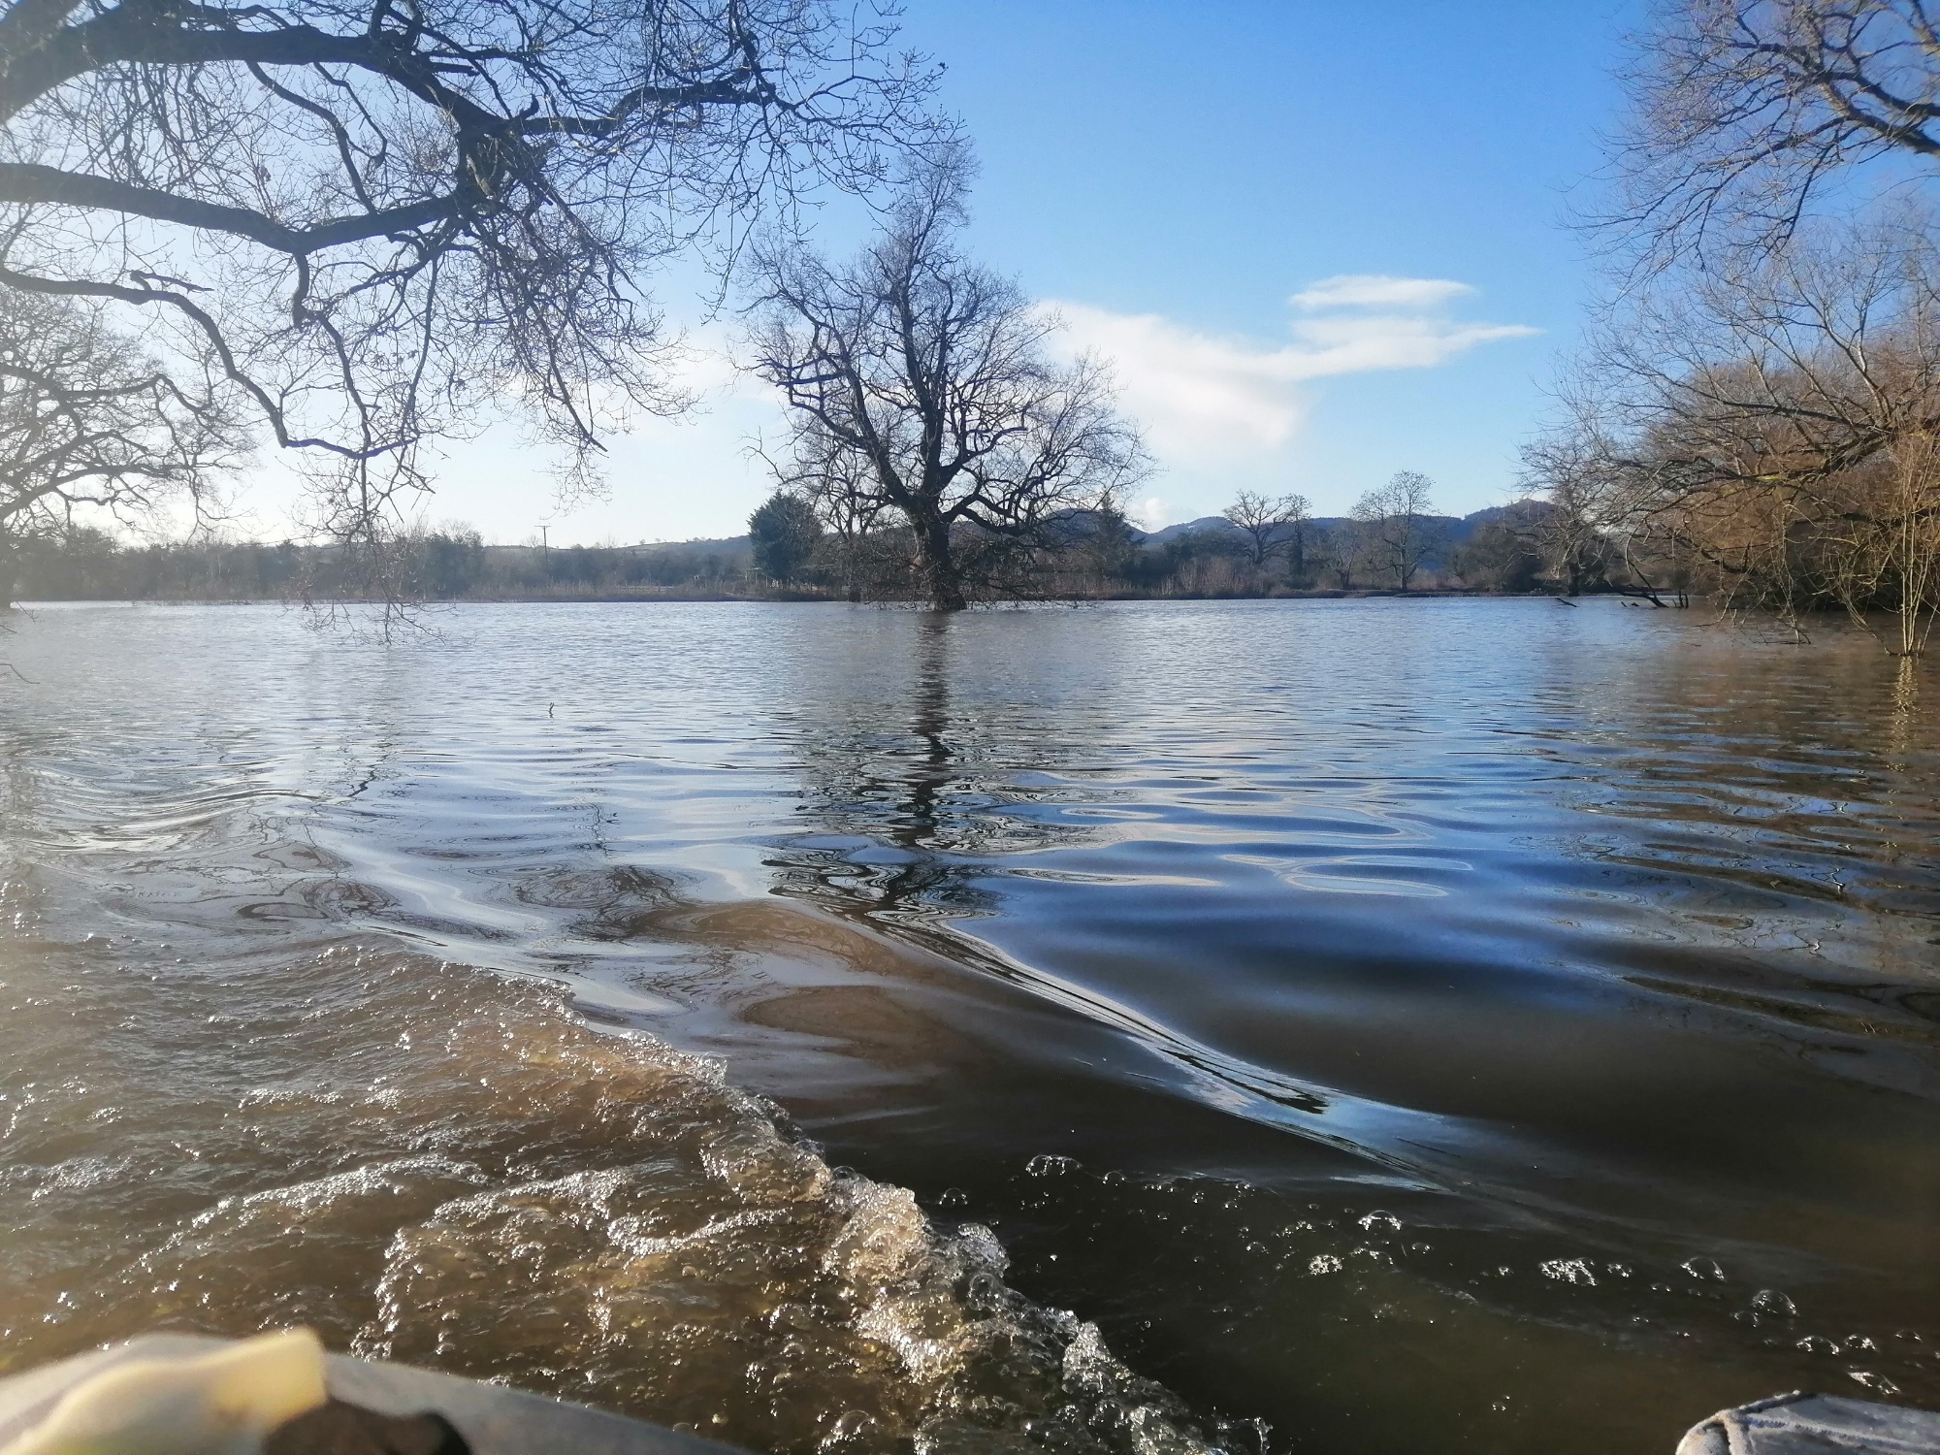
Melverley Common by boat, hedges submerged

Slide 39
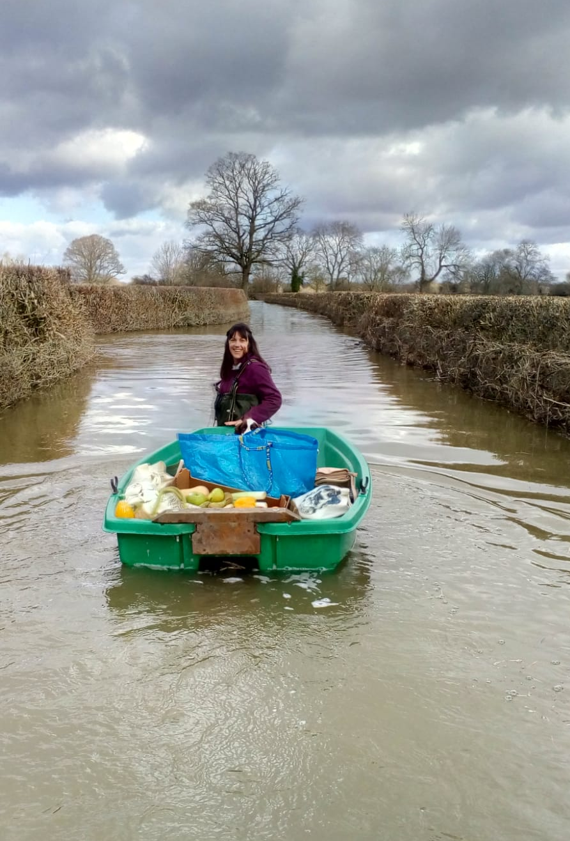
Transporting supplies

Slide 40
Maesbrook

Slide 41
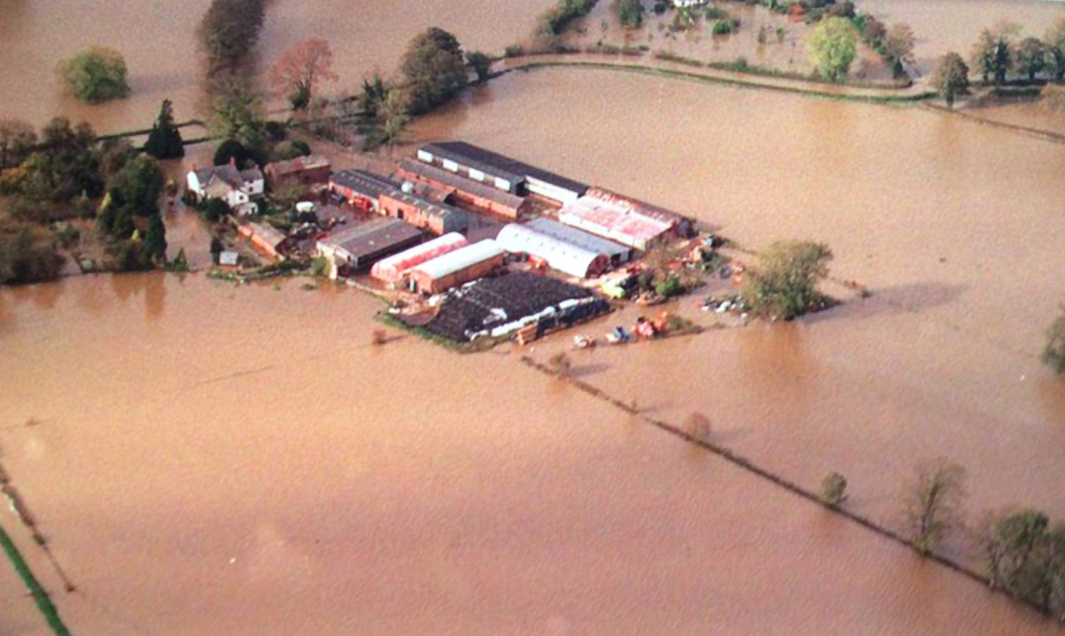
Dyffryd, Maesbrook

Slide 42
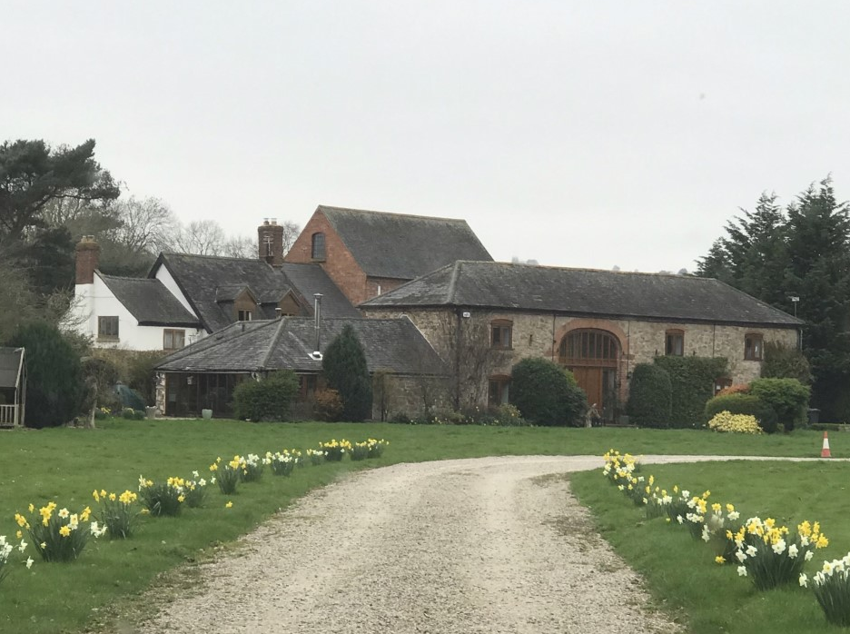
The Old Barn, Llwyntidmon Mill (River Morda flood)

Slide 43
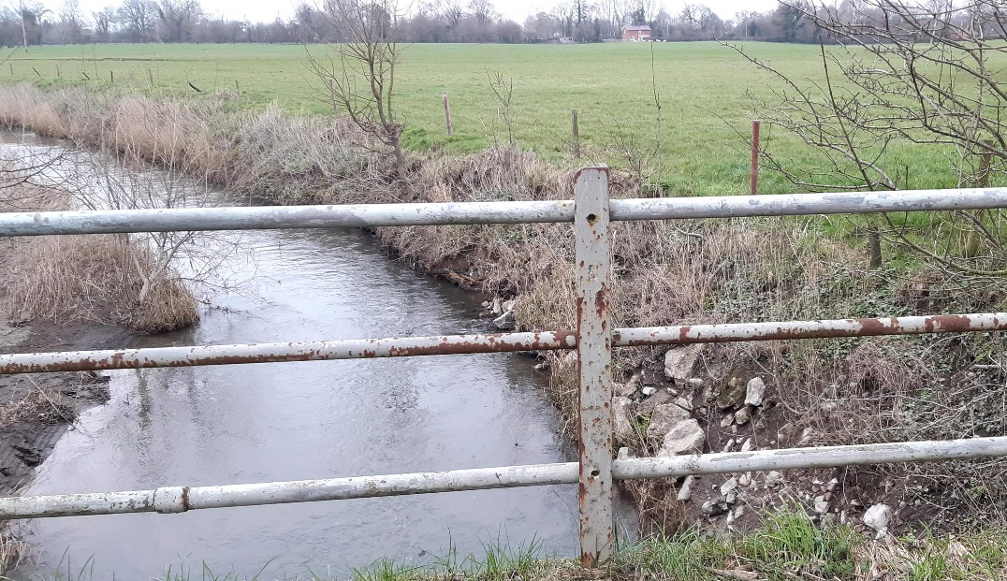
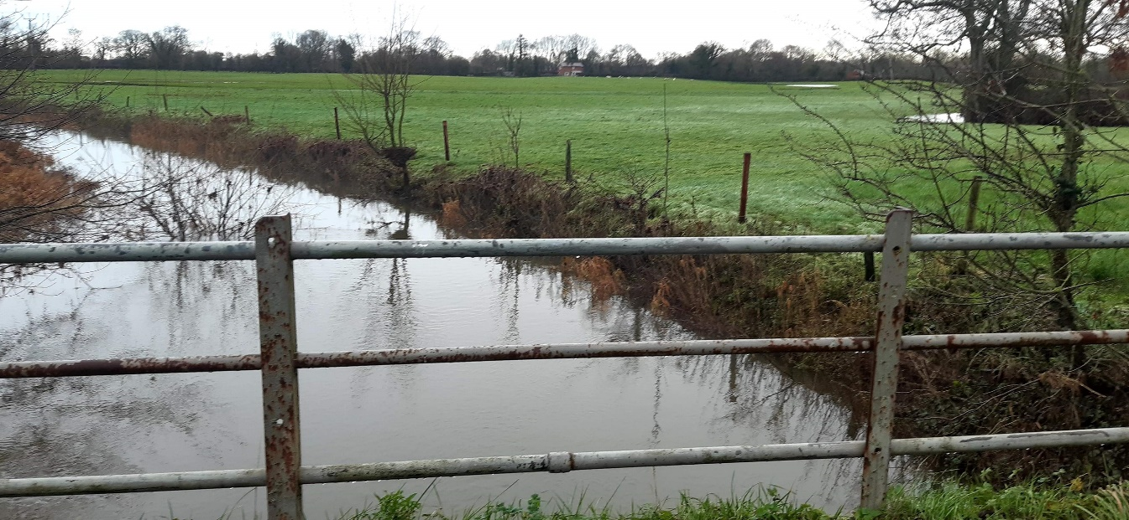
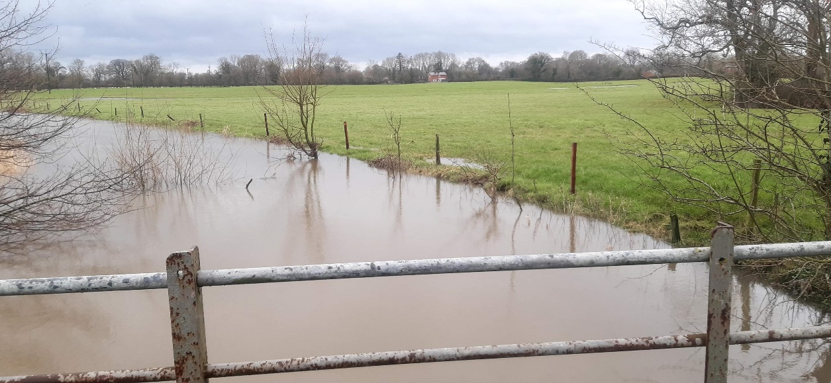
Morda Bridge, new cut, sequence
1: Normal
2: Backed up; all flow down Mill stream
3: At point of out-of-channel flow
4: Vyrnwy rising more; start of overland flow

Slide 44
EA/NRW Flood Risk Management Plan 2015-2021
The largest flood recorded occurred in 1947 which caused widespread damage and disruption. This event was triggered by a ‘rain on snow event’ where relatively warm rain fell onto snow resulting in rapid melting of the snowpack. For many communities, the 1947 event is the highest recorded event in living memory.
Since then large catchment-wide flood events have been relatively rare until those experienced in October 1998 and the autumn of 2000 which impacted on many communities.
In February 2011 significant flooding occurred along the River Vyrnwy resulting in the highest levels recorded since records began in many locations.
This doesn’t mention the 1960 flood, which was particularly disastrous

Slide 45
The lethal consequences of the 1960 flood (G A Whitworth 2008 - Wellbeing and Flood Risk)

Slide 46
Hansard, 15 December 1960, debate on flooding
In the early hours of Sunday, 4th December, the County of Montgomery and its people suffered the greatest disaster that has ever been known, not only in living memory but in the records of that county.
The river rose very rapidly on Saturday afternoon until, about midnight, it had reached very nearly 12 ft. above normal. Most of the animals were already in their buildings and, of course, the people themselves were asleep. In all, 360 cattle, 965 sheep, 292 pigs, 4,800 head of poultry, six horses and one dog were lost. There was also a very serious tragedy in Newtown.
In the early 1880s, the Vyrnwy was blocked by the Liverpool Corporation and Lake Vyrnwy was created. This has had a very salutary effect in reducing the flooding of the Vyrnwy, which is the strongest stream flowing into the Severn all the way from its source to the point where it reaches the Bristol Channel.
There are two strong streams which ultimately become the Severn. One is known as the Severn, which rises up in Plinlimmon, and the other is known as the Clywedog. Our proposal was that those rivers should be blocked in the same way as the Vyrnwy had been.
Llyn Clywedog was of course built, but Clement Davies died before its completion. The Severn was diverted in Newtown, and flood barriers were installed.

Slide 47
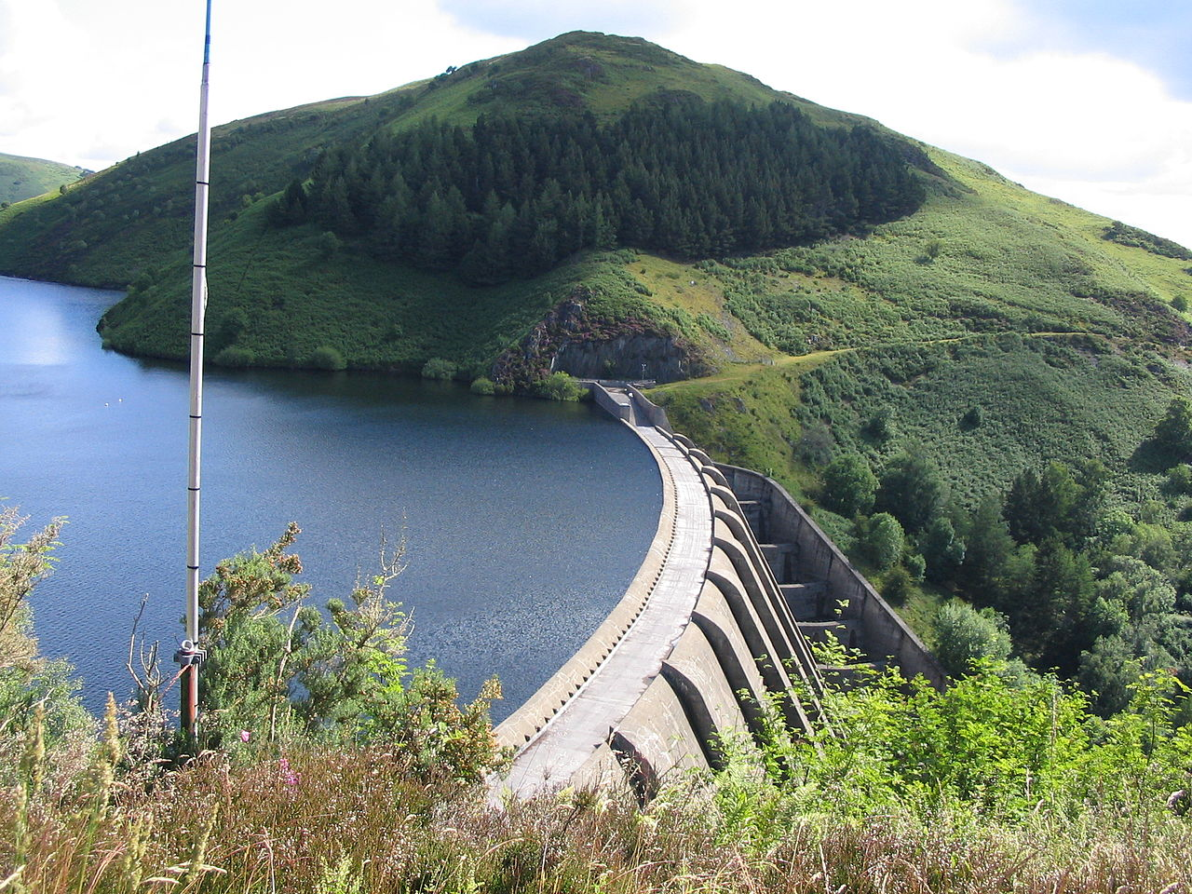
Llyn Clywedog
Full !

Slide 48
A plaque on the viewing platform at Llyn Clywedog stated that it is a round headed mass concrete buttress dam, which at the time of completion in 1967 was the tallest dam in the British Isles. It was built to improve and regulate the flow of water in the River Severn and to reduce flooding in the upper Severn valley.

Slide 49
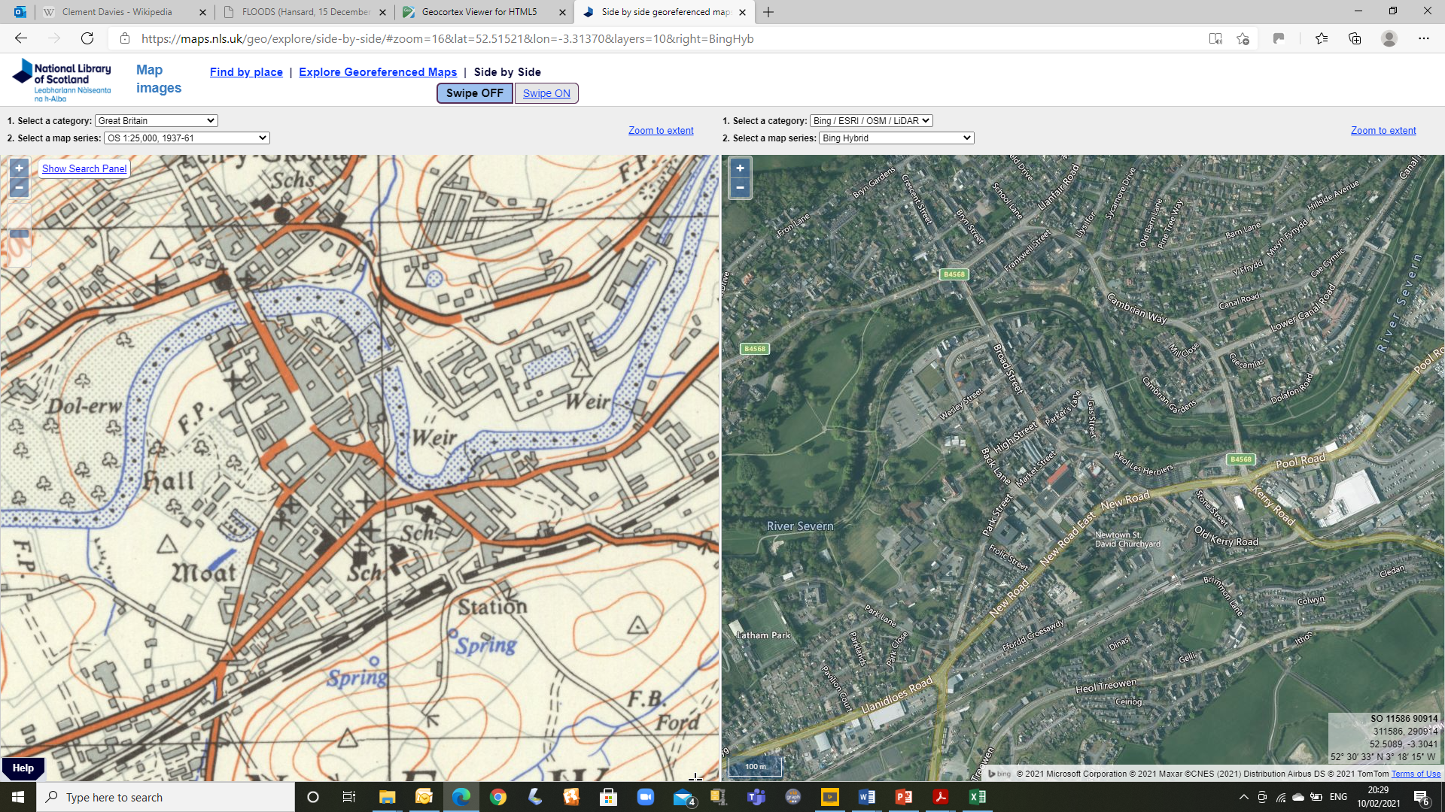
Newtown river diversion

Slide 50
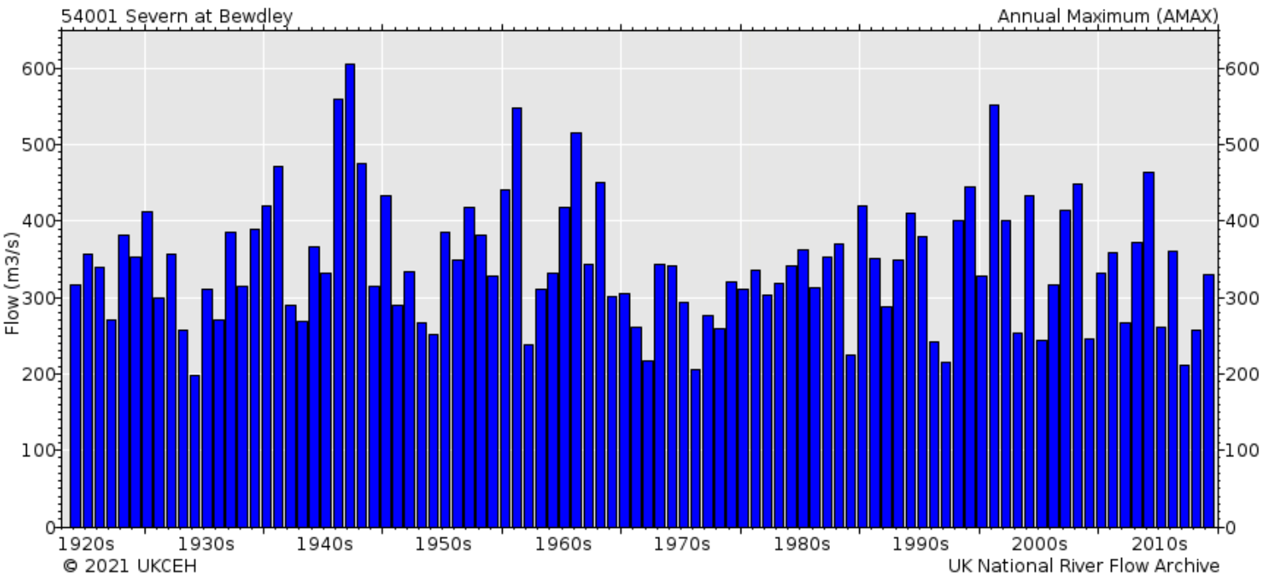
Severn at Bewdley
Annual peak flow data https://nrfa.ceh.ac.uk/data/station/peakflow/54001
Feb 1946
Mar 1947
Dec 1960
Dec 1965
Nov 2000

Slide 51
The confluence of the Rivers Vyrnwy and Severn demands management of some of the highest fluvial floods in the UK. Both rivers can exceed 650 cumecs, and their peak flows can coincide. (G A Whitworth 2008 - Wellbeing and Flood Risk)
The water flows down in waves through the natural gorges, spreading out and pinching in again. Our ‘stage’ is effectively from Shrawardine upstream to Llanymynech on the Vyrnwy and to Pool Quay on the Severn.
Confluence Flood Zone 3
Lake Vyrnwy
Clywedog
EA flood risk map

Slide 52
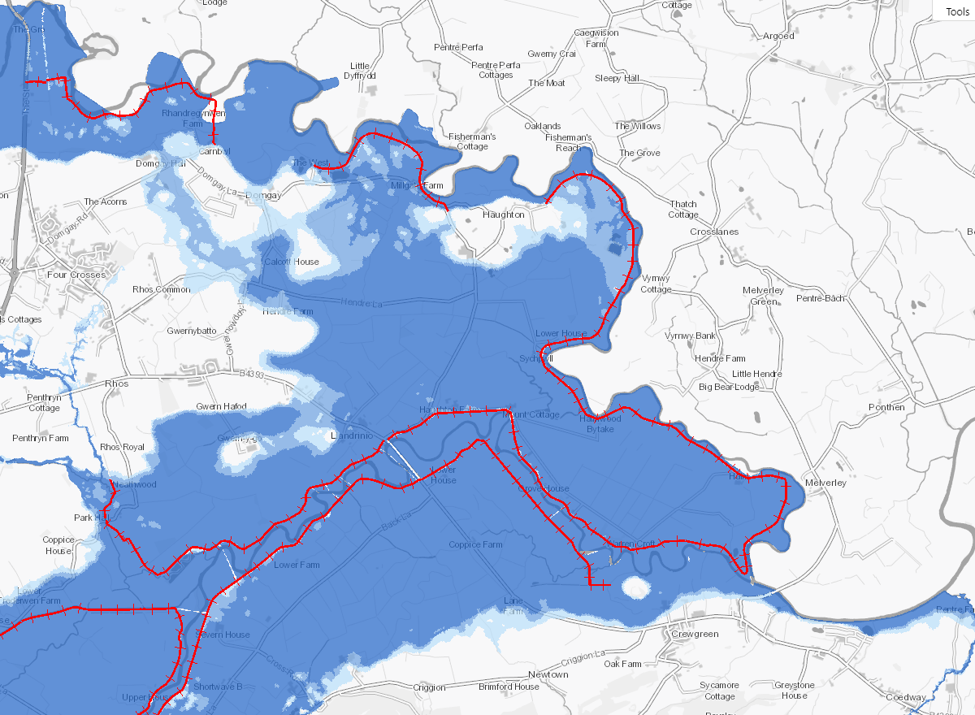
Flood risk maps
NRW: Geocortex Viewer for HTML5 (cyfoethnaturiolcymru.gov.uk)
Environment Agency: Learn more about flood risk - GOV.UK (flood-warning-information.service.gov.uk)
(Wales only)
(England only)

Slide 53
Flood risk https://floodassist.co.uk/resources/flood-risk (England and Wales)

Slide 54
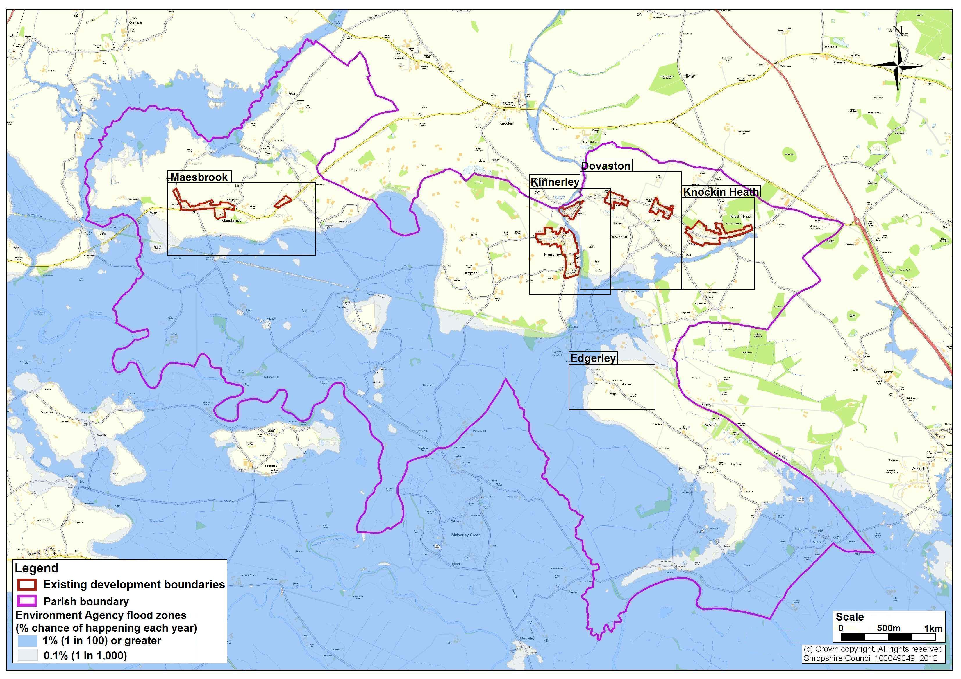
Flood risk map for Kinnerley Parish and surrounds
From Kinnerley Parish Neighbourhood Plan Questionnaire for Residents May 2012, page 30

Slide 55
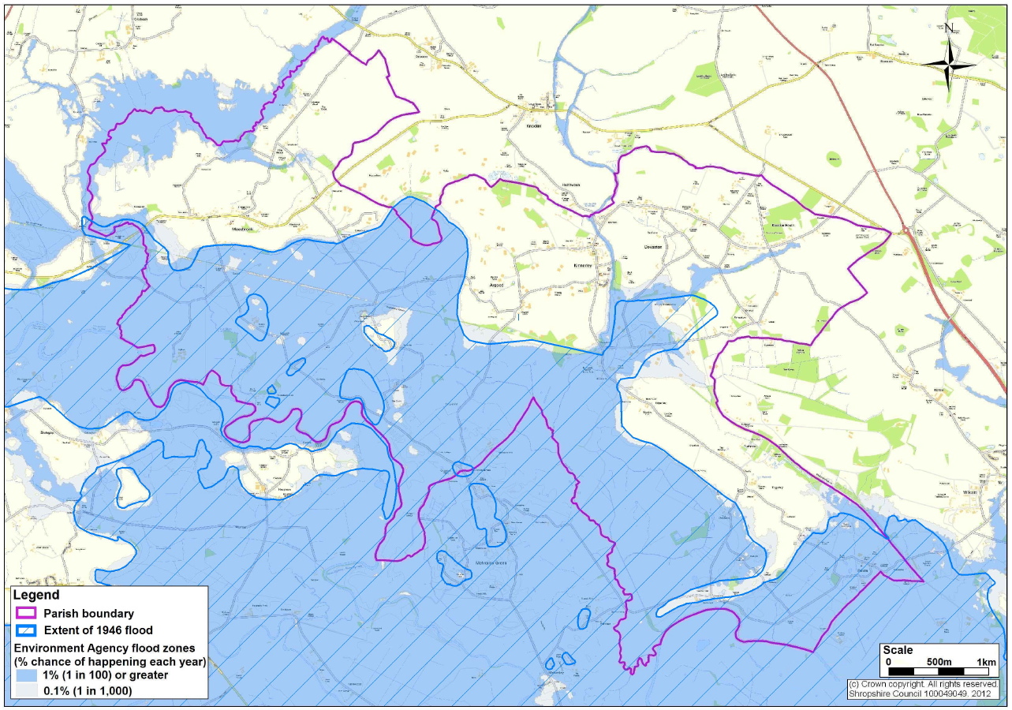
Extent of February 1946 flood

Slide 56
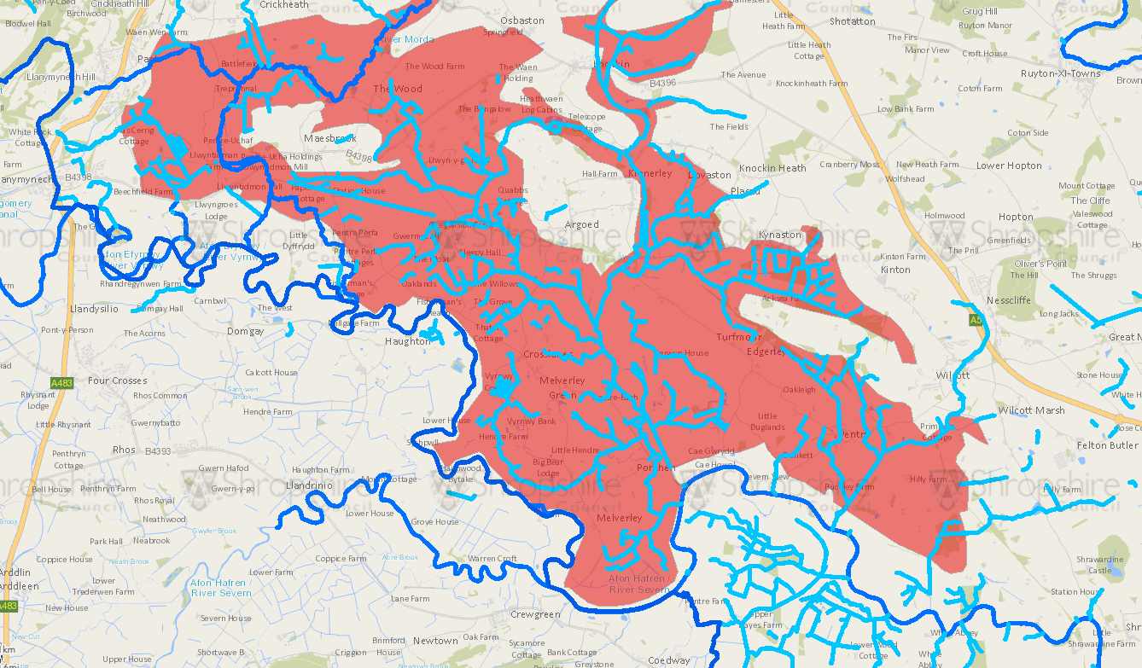
Melverley Internal Drainage Board area (and watercourses)
Flood & Water Management (arcgis.com) – see also https://www.ada.org.uk/idb-map/

Slide 57
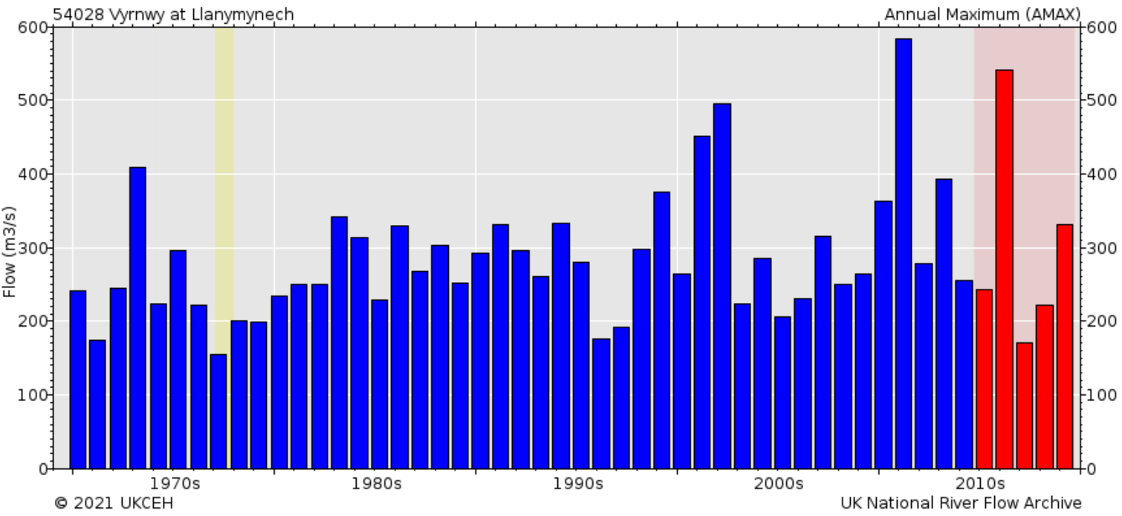
Vyrnwy at Llanymynech
Annual peak flow data https://nrfa.ceh.ac.uk/data/station/peakflow/54028
Aug 1973
Oct 2000
Feb 2002
Feb 2011
Dec 2015

Slide 58
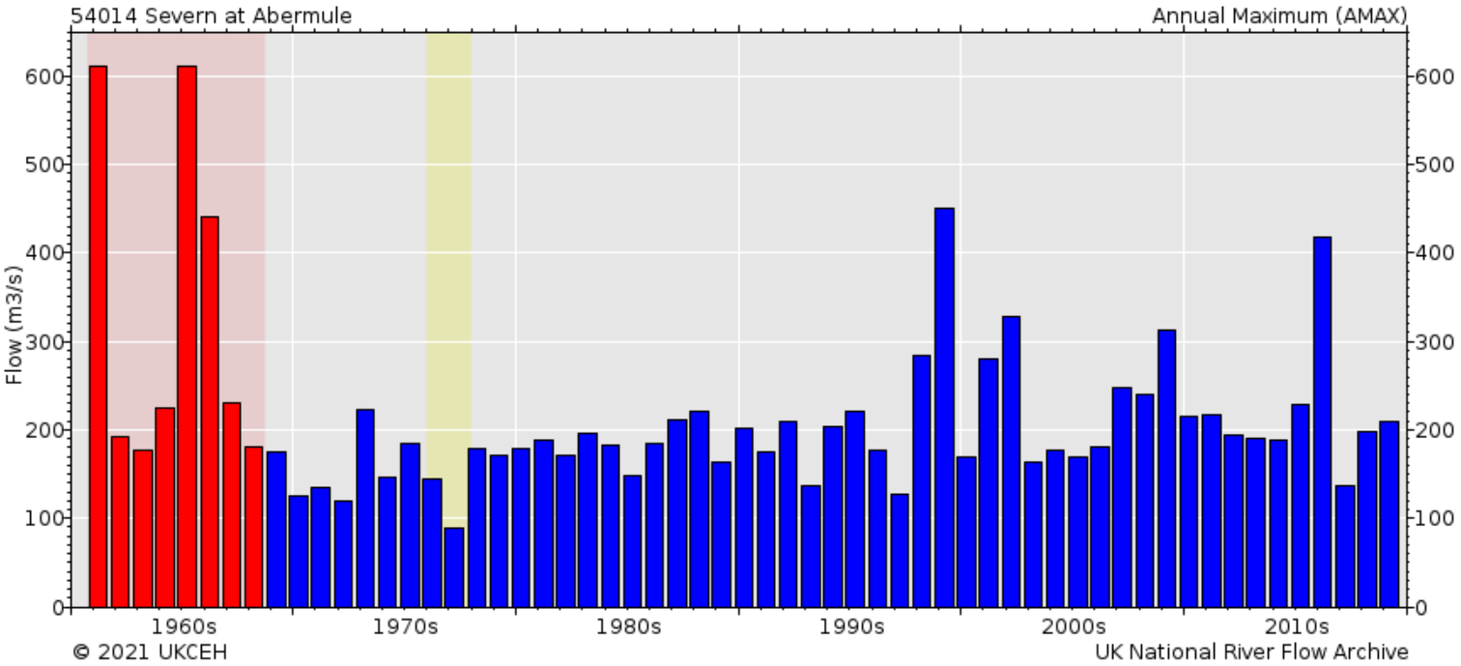
Severn at Abermule
Annual peak flow data https://nrfa.ceh.ac.uk/data/station/peakflow/54014
Dec 1960
Dec 1964
Dec 1965
Oct 1998
Nov 2015

Slide 59
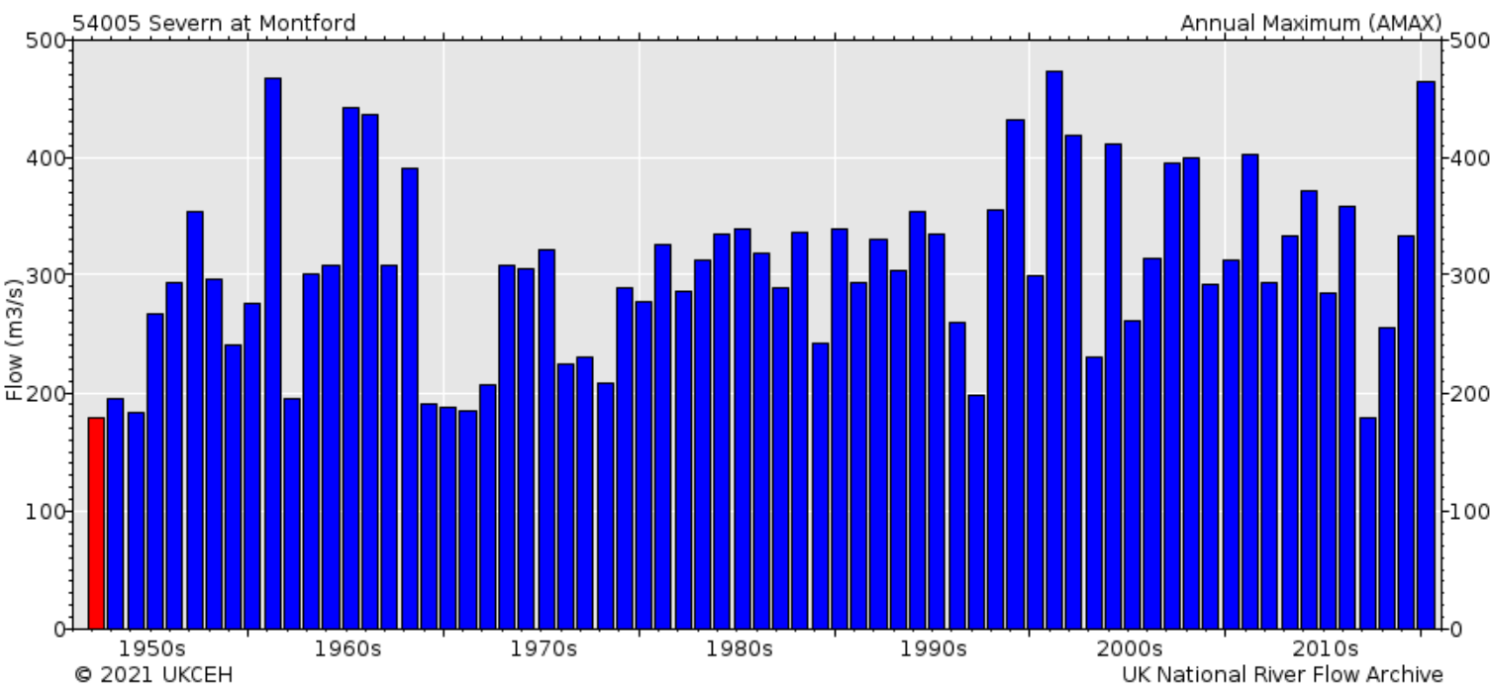
Montford is a pinch point
Annual peak flow data https://nrfa.ceh.ac.uk/data/station/peakflow/54005
Dec 1960
Dec 1964
Dec 1965
Oct 1998
Oct 2000
Feb 2002
Feb 2020

Slide 60
Montford again – last 12 months levels and flows
https://floodassist.co.uk/river-data/gauges/shropshire
Levels
Flows
Ml/d

Slide 61
The argaes (flood banks)
A precise system of mutually dependent argaes (flood banks)
Clement Davies again (15 December 1960 debate on flooding)
The experience of the flooding Severn extends over centuries. I believe that the embankments along either side of the river were started in early Norman times. They are put well back from the river, but, of course, the river keeps changing its course, moving nearer to one and further from the other. So far as we know, an effort was made to repair them and put them right in Tudor times, again in Cromwellian times and, last of all, at the end of the eighteenth century and the beginning of the nineteenth century [Thomas Telford involved]. The embankment has fallen into a sad state of repair. Very often, gaps have been made, and these add to the trouble. When the river rises, the water goes through a gap and then, of course, it cannot return to the river itself because the embankment stands between it and the ordinary river bed.
The first thing I ask is that a survey be made of the embankments to see what is needed and to put matters right.
The argaes have been built mostly along the higher ground fairly close to the river channel. High volumes of out channel flood flow are carried between the argaes. The empty flood plain beyond them must be ready to receive the water which will overtop them when the overwhelming flood events occur.
Other structures, for instance the old railway embankment, also affect the flow of the flood waters.
Much has been done subsequent to the 1960s, changing levels, alignments and widths, but survey work and putting matters right is an ongoing request. A map of the argaes would be useful too.

Slide 62
Water spilling over argae immediately south of Melverley Bridge, just south of Severn/Vyrnwy confluence, January 2021

Slide 63
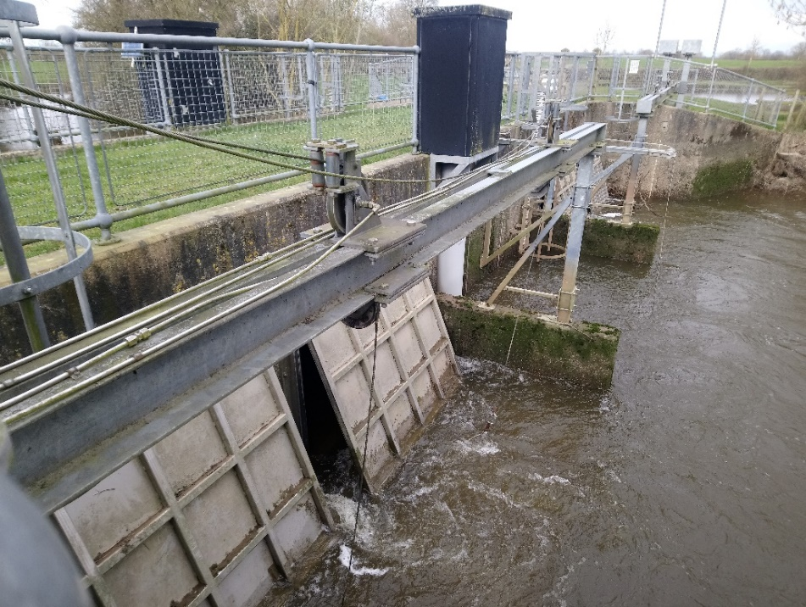
The doors
The main rivers are fed by the smaller streams. The bank-full and out of channel floodwater has to be stopped from escaping early, to avoid reducing the capacity and ability of the vast areas to absorb the volumes which follow. These river feeding streams are of course the drainage systems of the whole of our area and are continuously flowing.
Over the years structures with flap doors have been fitted to all but a few of these streams.
These flap doors hang from the top, and shut tightly to stop the river water from leaving the main channel. They remain shut under great pressure of water until the level of the main channel drops.
But the water carries on coming down the side stream and backs up. It can be considerable and easily mistaken for main river flood.
Pumps
On the Welsh side of the river system, pumps are used. At the outfall to the Sarnwen Brook (opposite The Shores in Melverley parish), there are two pumps in operation, with a third in reserve
The New Weir Brook outfall ‘structure’ and gauges

Slide 64
Environment Agency map of ‘assets’ - English side of river only (received 1/3/21)

Slide 65
These two sheets of Severn / Vyrnwy confluence flood defences were produced in order to show the defences both sides of the border

Slide 66
Flood defences
NRW: Geocortex Viewer for HTML5 (cyfoethnaturiolcymru.gov.uk)
Environment Agency: ArcGIS - My Map
(Wales only)
(England only)

Slide 67
Environment Agency map of ‘assets’ - English side of river only (received 1/3/21)
Approximate area covered in next slide

Slide 68
The reach between the Vyrnwy confluence and Montford is notoriously difficult to simulate because of the interaction between the Vyrnwy and Severn channels, the Morda gap and floodplain flow
(Couperthwaite 1997)

Slide 69
Wern Ddu flood doors
Dyffryd flood doors
Looking north
Looking south
Looking north
Looking south
Flood opening in Old Potts railway embankment

Slide 70
Morda Bridge, new cut, sequence
1: Normal
2: Backed up; all flow down Mill stream
3: At point of out-of-channel flow
4: Vyrnwy rising more; start of overland flow

Slide 71
Environment Agency map of ‘assets’ - English side of river only (received 1/3/21)
Approximate area covered in next slide

Slide 72
MIDB maintained sluice
The Dunkett sluice
This “missing” section of argae was completed in the early 2000s, subsequent to this mapping
NRW sluice
Crew Green gauge
Weir Brook sluice
New Cut Weir Brook sluice & Cae Howell gauges
Buckley Farm sluice
Inspection chambers

Slide 73
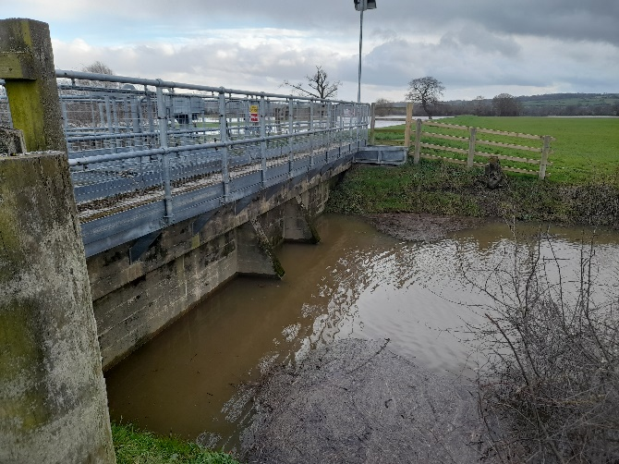
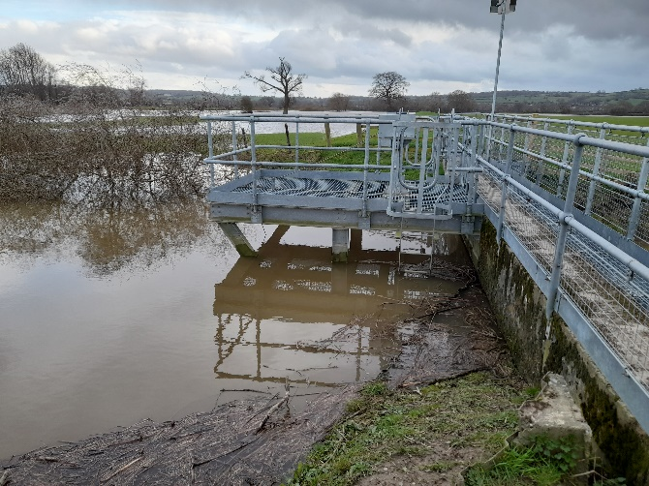
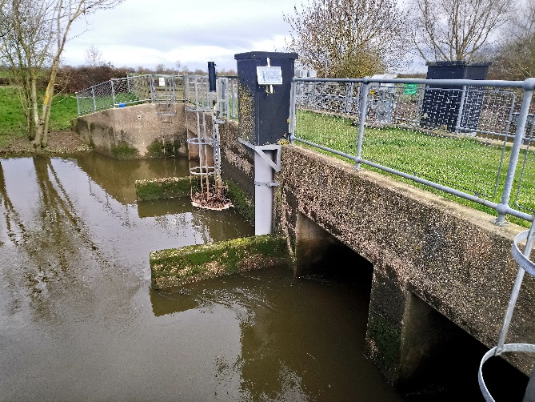
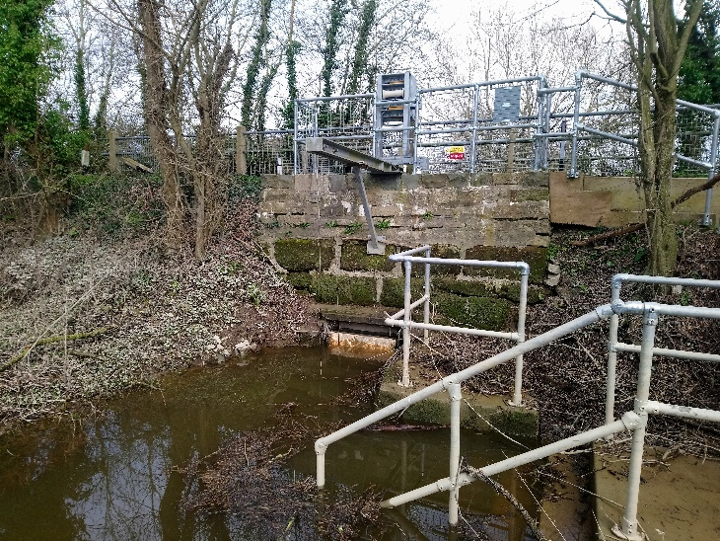
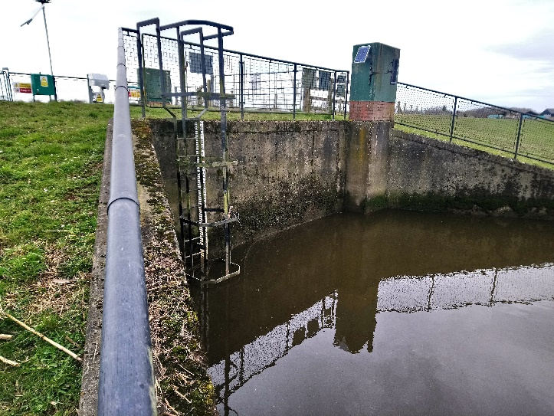
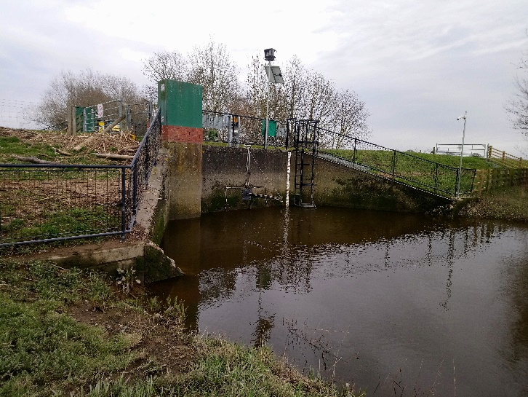
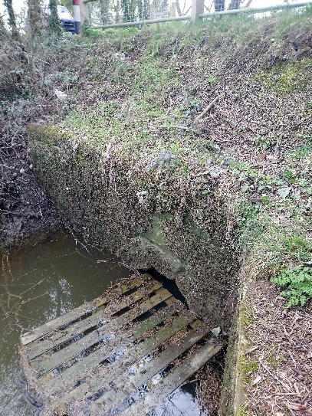
Weir Brook sluice/flood doors
New Cut, Weir Brook sluice/flood doors, and Cae Howell gauges
(two doors below, four doors above)
Upstream
River side
Upstream
River side
The Dunkett sluice/flood door
Buckley Farm sluice/flood doors
East side (upstream)
West side (downstream)
North side (upstream)
South side (downstream)

Slide 74
Inspection chambers, Buckley Farm
Drainage through Buckley Farm argae
North side (upstream)
South side (downstream)
MIDB maintained sluice, leading to Weir Brook New Cut

Slide 75
Crew Green gauge
River Severn at Crew Green :: the UK River Levels Website
The Crew Green gauge has been repeatedly faulty for months, including throwing false “spikes” to 16.96m; this was the automatically generated display on 08/05/2021, with a flood alert in force for the Severn Vyrnwy confluence, after heavy rain

Slide 77
Storage capacities Three main areas of storage upstream of Shrewsbury which store water during a flood event (Environment Agency: Shrewsbury Flood Alleviation Scheme, March 2001)
Lake Vyrnwy – 60,000,000 cu m
Built in the 1890s for Liverpool’s water supply. 210,000 cu m per day treated at Oswestry en route to Prescot reservoirs
Catchment represents only 4% of the total catchment area to Shrewsbury
25,000 – 45,000 cu m per day of compensation water can be released into the river Vyrnwy
Llyn Clywedog – 50,000,000 cu m
Built in the 1960s to regulate flow on the Severn
Catchment represents only 1.8% of the total catchment area to Shrewsbury
Severn/Vyrnwy confluence – 20,000,000 cu m
Held back by sluice gates when the argaes are overtopped
1 cu m of water = 1 tonne
1 cumec = 1 cu m of water per sec, 86,400 cu m per day
450 cumec for a day = 38,880,000 cu m
Note: statements from EA report above in red are thought to be misleading:
%s by area might be right but by rainfall will be much higher
There are now flap-doors rather than sluice gates

Slide 78
River levels, rainfall and sea data (naturalresources.wales)
Clywedog Reservoir Level, last 12 months
Clywedog at Bryntail, last 12 months

Slide 80
Jacobs/Mouchel report June 2009
62.30m is also the predicted peak level at around Llandrinio Bridge
How many more houses would be submerged than now?

Slide 81
This map shows Save Our Severn’s modelling of two possible reservoir levels. 59.2m is the proposed spillway height and 61.8m is the level required to hold the 2000 flood, making this the largest freshwater reservoir by area in the UK. This huge area of shallow water would need to be drained empty after every flood event in order to catch the next flood, creating a huge deserted plain of land 1,000s of hectares in size.

Slide 82
Catchment wide/holistic remedies for flooding Being looked at by:
The Severn Valley Water Management Scheme (SVWMS)
Our aim is to make the Severn Valley more resilient to climate change by adopting a range of measures that will work together to reduce flood risk, manage water resources and enhance the environment
Severn Valley Water Management Scheme - Environment Agency - Citizen Space (environment-agency.gov.uk)
River Severn Partnership (RSP)
The aim of the Partnership is to make the Severn Catchment Britain’s most vibrant and resilient river network; where an exceptional quality of life, prosperous local economies and an outstanding natural environment is driven by a programme of innovation to reduce flood risk, secure future water resources and improve and deliver shared natural assets
River Severn Partnership
SVWMS project team’s modelling taking account of climate change indicates peak flows of something above 700 cumecs, immediately upstream of Shrewsbury at a single point
They aim, with a catchment-wide approach, to reduce that to 350 cumecs
It is recognised that Natural Flood Management and similar measures are unlikely to be able to provide the capacity to reduce the design flows from 700 cumecs to 350 cumecs, but that they could be part of a package that would inevitably also include engineered solutions “somewhere in the catchment”

Slide 83
River Severn Partnership area and who’s involved
(last updated in November 2020 but liable to change)
The area covered is based on catchment boundaries

Slide 84
Environment Agency Please continue to maintain and improve the infrastructure
River Severn Partnership
Don’t make things worse for us with your wild plans and wild claims

